Slide 1
PATIENT-CENTERED MANAGEMENT

Slide 2
Overview
I. Impact of diagnosis
II. Quality of life and utility
III. Activities of daily living
IV. Reading
V. Mobility
VI Falls
VII. Driving
VII.1. Mental Health
VIII. Medication adherence
VIII.1. Ocular Surface Disease
IX. Low vision services
X. Appendix: GQL-15

Slide 3
Impact of diagnosis
Patient perspective: “Oh my, I’m going blind!”
Fear of blindness¹
34% of patients report at least moderate fear
Associated with younger age, being white, less education and lower income
After 3 years, fear of blindness is associated with VF progression
Over time, the strongest association is with self-perceived inability to perform visual tasks, rather than VA or VF
VA, visual acuity; VF, visual field.
1. Janz NK et al.; Collaborative Initial Glaucoma Treatment Study (CIGTS). Ophthalmology 2007; 114: 2213–20.
Notes:
Reference
Janz NK, Wren PA, Guire KE, Musch DC, Gillespie BW, Lichter PR; Collaborative Initial Glaucoma Treatment Study. Fear of blindness in the Collaborative Initial Glaucoma Treatment Study: patterns and correlates over time. Ophthalmology 2007; 114: 2213–20.

Slide 4
Impact of diagnosis
Patient perspective
Worse self-perceived visual function is associated with increased odds of depression¹
Need a focussed discussion at diagnosis regarding treatment efficacy and its relationship to blindness
Assess fear over time to ease ongoing concerns
1. Jampel HD et al.; CIGTS Study Group. Am J Ophthalmol 2007; 144: 238–244.
Notes:
References
1. Janz NK, Wren PA, Guire KE, Musch DC, Gillespie BW, Lichter PR; Collaborative Initial Glaucoma Treatment Study. Fear of blindness in the Collaborative Initial Glaucoma Treatment Study: patterns and correlates over time. Ophthalmology 2007; 114: 2213–20.
2. Jampel HD, Frick KD, Janz NK et al.; CIGTS Study Group. Depression and mood indicators in newly diagnosed glaucoma patients. Am J Ophthalmol 2007; 144: 238–244.

Slide 5
Impact of diagnosis
Patient perspective
People with glaucoma are more interested in those things that impact their quality of life – such as how comfortable they feel, how well they see and what they can do – rather than their optic disc or visual field

Slide 6
Quality of life
Measuring QOL with the GQL-15^{1,2}
4 factors (subscale scores)
Central and near vision
Reading, recognising faces
Peripheral vision
Uneven ground, steps, side objects, finding objects
Dark adaptation and glare
Walking after dark, seeing at night, adjusting to lights
Outdoor mobility
Judging distances, crossing roads, bumping, tripping
GQL-15, Glaucoma Quality of Life-15; QOL, quality of life.
1. Nelson P et al. J Glaucoma 2003; 12: 139–50; 2. Goldberg I et al. J Glaucoma 2009; 18: 6–12.
Notes:
References
1. Nelson P, Aspinall P, Papasouliotis O, Worton B, O'Brien C. Quality of life in glaucoma and its relationship with visual function. J Glaucoma 2003; 12: 139–50.
2. Goldberg I, Clement CI, Chiang TH et al. Assessing quality of life in patients with glaucoma using the Glaucoma Quality of Life-15 (GQL-15) questionnaire. J Glaucoma 2009; 18: 6–12.

Slide 7
Quality of life
GQL-15
Glaucoma patients have significantly more difficulty in vision-related function than controls¹
QOL is affected even in mild glaucoma and the effect increases with disease severity¹ → need for early diagnosis
Even asymptomatic glaucoma patients may have reduced QOL¹
Impact of treatment (cost, side effects)²
Impact of diagnosis (depression, fear)^{3,4}
1. Nelson P et al. J Glaucoma 2003; 12: 139–50; 2. Altangerel U et al. Curr Opin Ophthalmol 2003; 14: 100–5; 3. Jampel HD et al.; CIGTS. Am J Ophthalmol 2007; 144: 238–244; 4. Janz NK et al.; CIGTS. Ophthalmology 2007; 114: 2213–20.
Notes:
References
1. Nelson P, Aspinall P, Papasouliotis O, Worton B, O'Brien C. Quality of life in glaucoma and its relationship with visual function. J Glaucoma 2003; 12: 139–50.
2. Altangerel U, Spaeth GL, Rhee DJ. Visual function, disability, and psychological impact of glaucoma. Curr Opin Ophthalmol 2003; 14: 100–5.
3. Jampel HD, Frick KD, Janz NK et al.; CIGTS Study Group. Depression and mood indicators in newly diagnosed glaucoma patients. Am J Ophthalmol 2007; 144: 238–244.
4. Janz NK, Wren PA, Guire KE, Musch DC, Gillespie BW, Lichter PR; Collaborative Initial Glaucoma Treatment Study. Fear of blindness in the Collaborative Initial Glaucoma Treatment Study: patterns and correlates over time. Ophthalmology 2007; 114: 2213–20.

Slide 8
Quality of life
Glau-QoL
Likewise, in a multicentre study, QOL correlated with glaucoma stage
Several domains of the Glau-QoL were worse for patients with more advanced stages of glaucoma
‘Anxiety and Burden of Treatment’ worse at first diagnosis, followed by worse quality of life in ‘Driving’, ‘Daily Life’, ‘Psychological Wellbeing’ and ‘Self-Image’ with more advanced disease
Béchetoille A et al. Acta Ophthalmol 2008; 86: 71–80.
Notes:
Reference
Béchetoille A, Arnould B, Bron A et al. Measurement of health-related quality of life with glaucoma: validation of the Glau-QoL 36-item questionnaire. Acta Ophthalmol 2008; 86: 71–80.

Slide 9
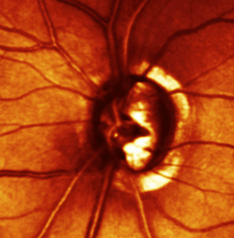
Quality of life
We have evidence from cross-sectional studies as to what aspects of QOL are affected by glaucoma, but we are lacking evidence as to when and how QOL and daily living are affected

Slide 10
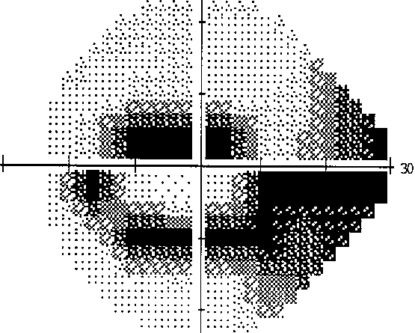
Quality of life
Research needed:
Longitudinal studies examining various aspects of vision, including the impact of VF loss in different areas on QOL
“What is the minimally important difference?”
“How much change in QOL is clinically important?”

Slide 11
Utility
Utility refers to the degree to which the patient values good vision
Time trade-off
Number of years of expected remaining life the patient is willing to trade for perfect vision
Standard gamble
Suppose a technology offered perfect vision when effective, but when not effective, the alternative was death or blindness
How high a risk of death/blindness would the patient be willing to accept before refusing treatment that would restore perfect vision?

Slide 12
Utility
Modest utility values for patients with glaucoma¹
May reflect mildness of symptoms²
May be different in developing countries
In India, VA loss secondary to glaucoma was associated with a substantial decrease in utility value, depending on the degree of VA loss and educational status³
1. Jampel HD et al. J Glaucoma 2002; 11: 154–63;
2. Spaeth G et al. Am J Ophthalmol 2006; 141 (1 Suppl): S3–14; 3. Gupta V et al. Br J Ophthalmol 2005; 89: 1241–4.

Slide 13
Activities of daily living
Loss of independence and increased nursing home admissions occur among glaucoma patients with vision loss
Impacts on family and carers
Bramley T et al. Arch Ophthalmol 2008; 126: 849–56.
Notes:
Reference
Bramley T, Peeples P, Walt JG, Juhasz M, Hansen JE. Impact of vision loss on costs and outcomes in Medicare beneficiaries with glaucoma. Arch Ophthalmol 2008; 126: 849–56.

Slide 14
Activities of daily living
What activities are important to patients?^{1,2}
More important
Central and near vision (reading)
Mobility outside the home (driving and walking)
Less important
Glare, bumping into objects, household chores
1. Burr JM et al. Optom Vis Sci 2007; 84: 797–808;
2. Aspinall PA et al. Invest Ophthalmol Vis Sci 2008; 49: 1907–15.
Notes:
References
1. Burr JM, Kilonzo M, Vale L, Ryan M. Developing a preference-based Glaucoma Utility Index using a discrete choice experiment. Optom Vis Sci 2007; 84: 797–808.
2. Aspinall PA, Johnson ZK, Azuara-Blanco A, Montarzino A, Brice R, Vickers A. Evaluation of quality of life and priorities of patients with glaucoma. Invest Ophthalmol Vis Sci 2008; 49: 1907–15.

Slide 15
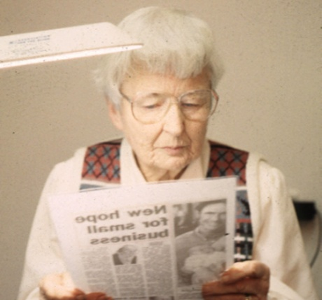
Reading
Advanced bilateral field loss is associated with impairment of spoken reading
Affects ~10% of glaucoma patients
Dependent on VA
Mediated through central field damage
Ramulu PY et al. Arch Ophthalmol 2009; 127: 82–7.
Notes:
Reference
Ramulu PY, West SK, Munoz B, Jampel HD, Friedman DS. Glaucoma and reading speed: the Salisbury Eye Evaluation project. Arch Ophthalmol 2009; 127: 82–7.

Slide 16
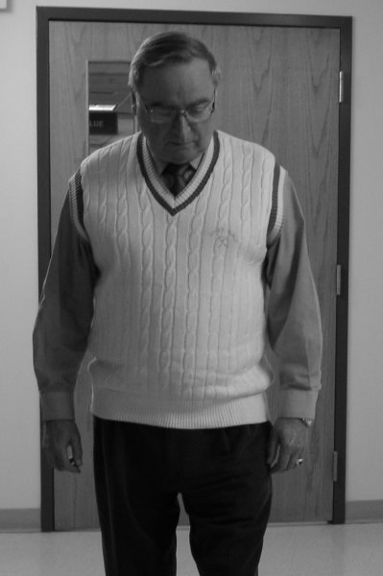
Orientation and mobility^{1,2}
Walking speed reduced
Significantly slower for persons with bilateral glaucoma versus no glaucoma¹
Speed decreases with disease severity²
Correlation with HFA 24-2 MD_{worse}
Significantly more bumps¹
1. Friedman DS et al. Ophthalmology 2007; 114: 2232–7; 2. Turano KA et al. Invest Ophthalmol Vis Sci 1999; 40: 2803–9.
HFA, Humphrey field analyser; MD, mean deviation.
Notes:
References
1. Friedman DS, Freeman E, Munoz B, Jampel HD, West SK. Glaucoma and mobility performance: the Salisbury Eye Evaluation Project. Ophthalmology 2007; 114: 2232–7.
2. Turano KA, Rubin GS, Quigley HA. Mobility performance in glaucoma. Invest Ophthalmol Vis Sci 1999; 40: 2803–9.

Slide 17
Falls
Glaucoma is a risk factor for falls^{1–3}
Falls are a leading cause of:^{4–7}
injury
hospitalisation
functional decline
nursing home placement
death
Falls are costly⁸
1. Ivers RQ et al. J Am Geriatr Soc 1998; 46: 58–64; 2. Haymes SA et al. Invest Ophthalmol Vis Sci 2007; 48: 1149–55; 3. Lamoureux EL et al. Invest Ophthalmol Vis Sci 2008; 49: 528–33; 4. Tinetti ME et al. J Am Geriatr Soc 1995; 43: 1207–13; 5. Tinetti ME et al. J Am Geriatr Soc 1995; 43: 1214–21; 6. Stevens JA et al. MMWR CDC Surveill Summ 1999; 48: 27–50; 7. Tinetti ME, Williams CS. N Engl J Med 1997; 337: 1279–84; 8. Carroll NV et al. J Manag Care Pharm 2005; 11: 307–16.
Notes:
References
1. Ivers RQ, Cumming RG, Mitchell P, Attebo K. Visual impairment and falls in older adults: the Blue Mountains Eye Study. J Am Geriatr Soc 1998; 46: 58–64.
2. Haymes SA, Leblanc RP, Nicolela MT, Chiasson LA, Chauhan BC. Risk of falls and motor vehicle collisions in glaucoma. Invest Ophthalmol Vis Sci 2007; 48: 1149–55.
3. Lamoureux EL, Chong E, Wang JJ et al. Visual impairment, causes of vision loss, and falls: the Singapore Malay Eye Study. Invest Ophthalmol Vis Sci 2008; 49: 528–33.
4. Tinetti ME, Doucette JT, Claus EB. The contribution of predisposing and situational risk factors to serious fall injuries. J Am Geriatr Soc 1995; 43: 1207–13.
5. Tinetti ME, Doucette J, Claus E, Marottoli R. Risk factors for serious injury during falls by older persons in the community. J Am Geriatr Soc 1995; 43: 1214–21.
6. Stevens JA, Hasbrouck LM, Durant TM et al. Surveillance for injuries and violence among older adults. MMWR CDC Surveill Summ 1999; 48: 27–50.
7. Tinetti ME, Williams CS. Falls, injuries due to falls, and the risk of admission to a nursing home. N Engl J Med 1997; 337: 1279–84.
8. Carroll NV, Slattum PW, Cox FM. The cost of falls among the community-dwelling elderly. J Manag Care Pharm 2005; 11: 307–16.

Slide 18
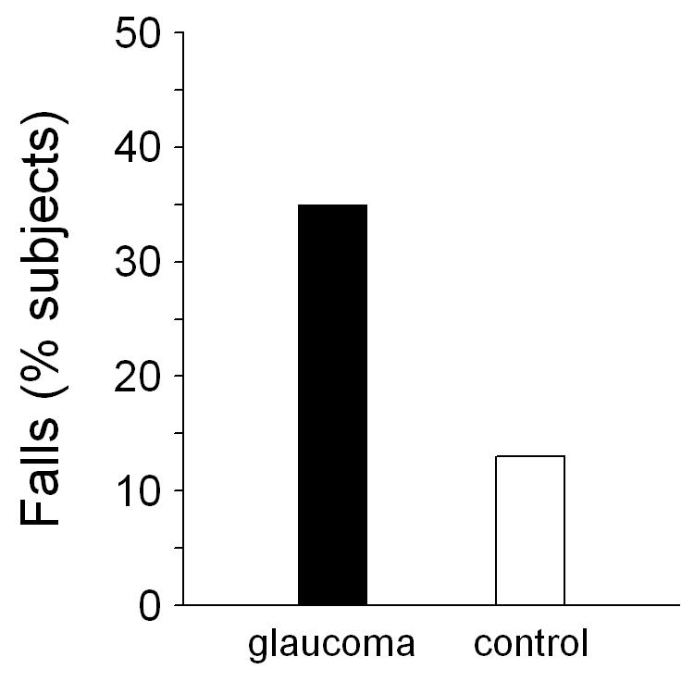
Falls
Compared with control subjects, glaucoma patients were over 3 times more likely to have fallen in the previous 12 months
Odds of a fall = 3.7
Haymes SA et al. Invest Ophthalmol Vis Sci 2007; 48: 1149–55.
Notes:
Reference
Haymes SA, Leblanc RP, Nicolela MT, Chiasson LA, Chauhan BC. Risk of falls and motor vehicle collisions in glaucoma. Invest Ophthalmol Vis Sci 2007; 48: 1149–55.

Slide 19
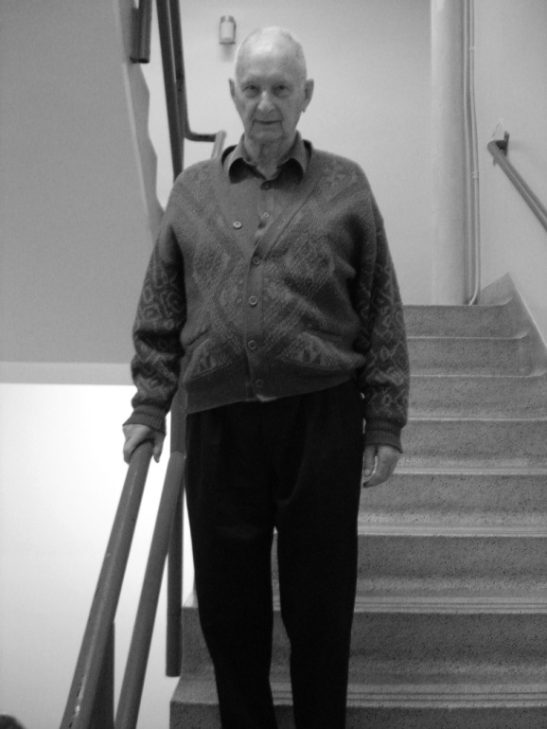
Falls
Multifocal spectacles may further increase the risk of falls
Outside the home
When walking up or down stairs
Lord SR et al. J Am Geriatr Soc 2002; 50: 1760–6.
Notes:
Reference
Lord SR, Dayhew J, Howland A. Multifocal glasses impair edge-contrast sensitivity and depth perception and increase the risk of falls in older people. J Am Geriatr Soc 2002; 50: 1760–6.

Slide 20
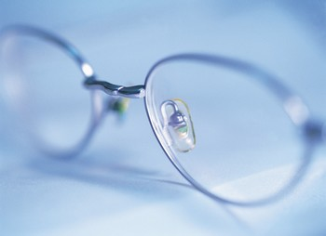
Falls
Advise on vision
Refractive error/spectacle correction
Update correction to give optimal vision
Consider single vision correction for those who are active outdoors – but be careful in patients who currently wear multifocals and undertake little outdoor activity
Haran MJ et al. BMJ 2010; 340: c2265. doi: 10.1136/bmj.c2265.
Notes:
Reference
Haran MJ, Cameron ID, Ivers RQ et al. Effect on falls of providing single lens distance vision glasses to multifocal glasses wearers: VISIBLE randomised controlled trial. BMJ 2010; 340: c2265. doi: 10.1136/bmj.c2265.

Slide 21
Falls
Advise on vision
Cataract surgery^{1,2}
Lighting
Improve lighting in general and eliminate dark areas; have a bedside lamp; install a night light
Avoid frequent transitioning form bright to dark and from too bright (intense sunlight) to dark
Contrast
Improve contrast in general; consider painting the edge of any steps white (or a contrasting colour); avoid mats, but if present choose a contrasting colour to the rest of the floor
1. Harwood RH et al. Br J Ophthalmol 2005; 89: 53–9; 2. Foss AJ et al. Age Ageing 2006; 35: 66–71.
Notes:
References
1. Harwood RH, Foss AJ, Osborn F, Gregson RM, Zaman A, Masud T. Falls and health status in elderly women following first eye cataract surgery: a randomised controlled trial. Br J Ophthalmol 2005; 89: 53–9.
2. Foss AJ, Harwood RH, Osborn F, Gregson RM, Zaman A, Masud T. Falls and health status in elderly women following second eye cataract surgery: a randomised controlled trial. Age Ageing 2006; 35: 66–71.

Slide 22
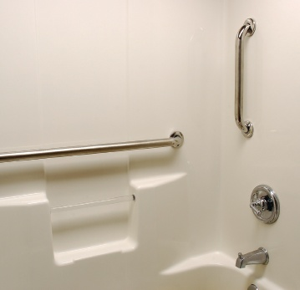
Falls
Advise on home environment safety
Trip hazards
Remove rugs/mats, cords/wires, papers, shoes etc.
Bathroom
Use non-slip mats
Handrails and grab rails
Emergency numbers
Conveniently and easily located
Notes:
Impact of diagnosis

Slide 23
Falls
Advise on physical aspects
Exercising and keeping fit
Balance and coordination
Appropriate footwear
Support and mobility devices, where needed
Refer for low vision orientation and mobility training if appropriate
Advise on medications
Including OTC meds
Notes:
I

Slide 24
Driving
Important mode of transportation
Critical to independence, self-esteem, QOL
Cessation of driving is associated with social isolation and depression representing intense personal loss; also affects family and carers^{1,2}
1. Marottoli RA et al. J Am Geriatr Soc 1998; 46: 562–8; 2. Adler G et al. Soc Work Health Care 2005; 40: 75–87;
Notes:
References
1. Marottoli RA, Richardson ED, Stowe MH et al. Development of a test battery to identify older drivers at risk for self-reported adverse driving events. J Am Geriatr Soc 1998; 46: 562–8.
2. Adler G, Bauer MJ, Rottunda S, Kuskowski M. Driving habits and patterns in older men with glaucoma. Soc Work Health Care 2005; 40: 75–87.

Slide 25
Driving
Almost 50% of glaucoma patients
will have vision loss that results in
driving ineligibility¹
Glaucoma is associated with
self-reported driving difficulties²
Bilateral glaucoma is associated with driving cessation^{3,4}
1. Ang GS, Eke T. Eye (Lond) 2007; 21: 604–8.
2. Gutierrez P et al. Arch Ophthalmol 1997; 115: 777–84; 3. Ramulu PY et al. Ophthalmology 2009; 116: 1846–53; 4. Adler G et al. Soc Work Health Care 2005; 40: 75–87.
Notes:
References
1. Ang GS, Eke T. Lifetime visual prognosis for patients with primary open-angle glaucoma. Eye (Lond) 2007; 21: 604–8.
2. Gutierrez P, Wilson MR, Johnson C et al. Influence of glaucomatous visual field loss on health-related quality of life. Arch Ophthalmol 1997; 115: 777–84.
3. Ramulu PY, West SK, Munoz B, Jampel HD, Friedman DS. Driving cessation and driving limitation in glaucoma: the Salisbury Eye Evaluation Project. Ophthalmology 2009; 116: 1846–53.
4. Adler G, Bauer MJ, Rottunda S, Kuskowski M. Driving habits and patterns in older men with glaucoma. Soc Work Health Care 2005; 40: 75–87.

Slide 26
Driving
Avoidance of more challenging driving situations¹
Night driving
Fog, rain
Rush hour
Highway and high density
Men with glaucoma were more likely to report family concern about their driving than older persons with normal vision²
1. McGwin G Jr et al. Invest Ophthalmol Vis Sci 2004; 45: 3934–9; 2. Adler G et al. Soc Work Health Care 2005; 40: 75–87.
Notes:
References
1. McGwin G Jr, Mays A, Joiner W, Decarlo DK, McNeal S, Owsley C. Is glaucoma associated with motor vehicle collision involvement and driving avoidance? Invest Ophthalmol Vis Sci 2004; 45: 3934–9.
2. Adler G, Bauer MJ, Rottunda S, Kuskowski M. Driving habits and patterns in older men with glaucoma. Soc Work Health Care 2005; 40: 75–87.

Slide 27
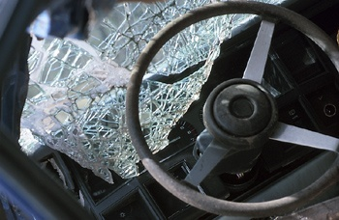
Driving
Increased risk for real-world and simulator motor vehicle crashes (MVCs)^{1–4}
More severe VF loss (HFA MD_{worse}) and poorer selective attention (UFOV) risk factors for at-fault MVCs³
UFOV, useful field of view
1. Hu PS et al. Accid Anal Prev 1998; 30: 569–81; 2. McGwin G Jr et al. Invest Ophthalmol Vis Sci 2005; 46: 4437–41; 3. Haymes SA et al. Invest Ophthalmol Vis Sci 2007; 48: 1149–55; 4. Szlyk JP et al. J Glaucoma 2005; 14: 145–50.
Notes:
References
1. Hu PS, Trumble DA, Foley DJ, Eberhard JW, Wallace RB. Crash risks of older drivers: a panel data analysis. Accid Anal Prev 1998; 30: 569–81.
2. McGwin G Jr, Xie A, Mays A et al. Visual field defects and the risk of motor vehicle collisions among patients with glaucoma. Invest Ophthalmol Vis Sci 2005; 46: 4437–41.
3. Haymes SA, Leblanc RP, Nicolela MT, Chiasson LA, Chauhan BC. Risk of falls and motor vehicle collisions in glaucoma. Invest Ophthalmol Vis Sci 2007; 48: 1149–55.
4. Szlyk JP, Mahler CL, Seiple W, Edward DP, Wilensky JT. Driving performance of glaucoma patients correlates with peripheral visual field loss. J Glaucoma 2005; 14: 145–50.

Slide 28
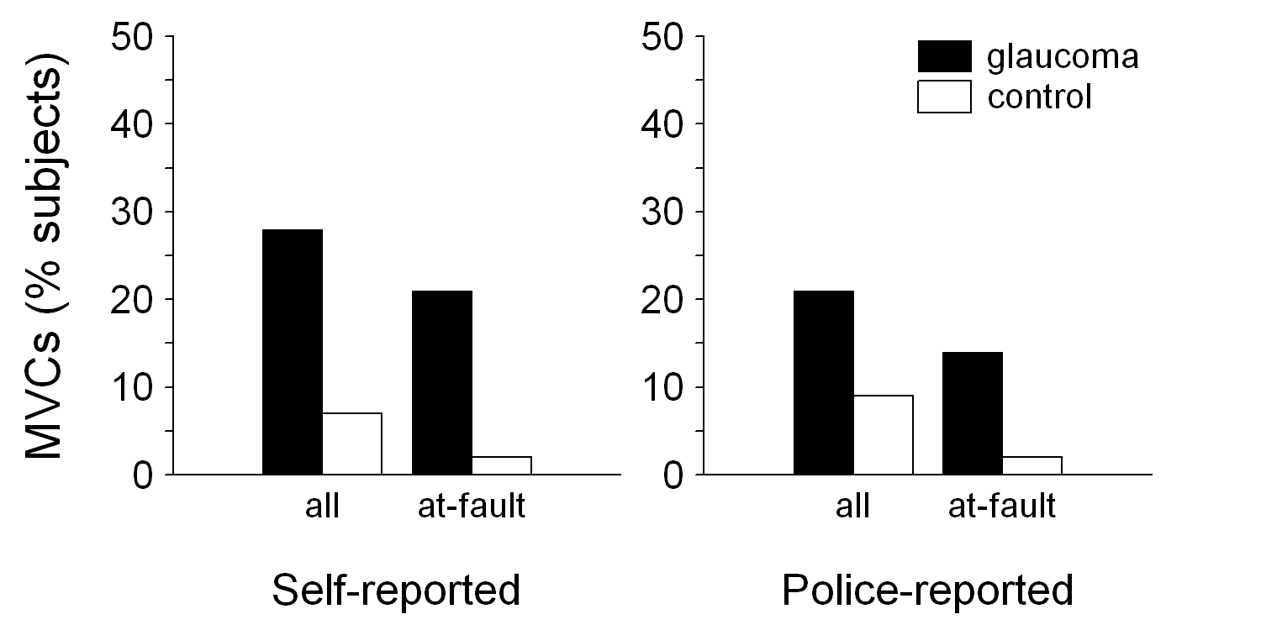
Driving
Odds of self-reported motor vehicle collision involvement = 6.6; at-fault 12.4
Haymes SA et al. Invest Ophthalmol Vis Sci 2007; 48: 1149–55.
Notes:
Reference
Haymes SA, Leblanc RP, Nicolela MT, Chiasson LA, Chauhan BC. Risk of falls and motor vehicle collisions in glaucoma. Invest Ophthalmol Vis Sci 2007; 48: 1149–55.

Slide 29
Driving
Glaucoma patients perform many on-road driving manoeuvres as well as control subjects
But, glaucoma patients are six times as likely as persons with normal vision to have difficulty detecting peripheral hazards and reacting to unexpected events on the road
Haymes SA et al. Invest Ophthalmol Vis Sci 2008; 49: 3035–41.
Notes:
Driving performance was tested in 20 patients with glaucoma and 20 age- and sex-matched control subjects with normal vision. Glaucoma patients had slight to moderate VF impairment. Instructors were unaware of participant's level of vision. There was no overall difference in skills, but glaucoma patients were six times as likely to have the driving instructor intervene (critical intervention).

Slide 30
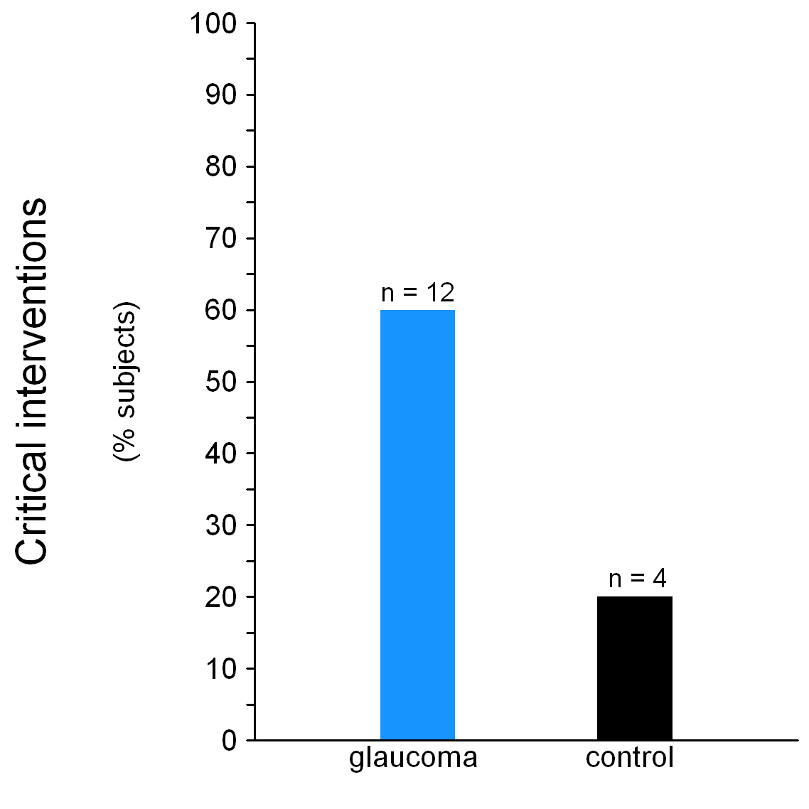
Driving
Critical interventions
Incidents that required the driving instructor to intervene to stop a potentially unsafe manoeuvre (either by applying the dual brake control or by taking over steering)
P = 0.01
Haymes SA et al. Invest Ophthalmol Vis Sci 2008; 49: 3035–41.
Notes:
Critical interventions during driving were required for 12 (60%) of glaucoma patients, compared with 4 (20%) of controls (odds ratio = 6, 95% CI, 1.46–24.69). The most common reason for intervention was failure to see and give way to a pedestrian.

Slide 31
Driving
Inquire about:
driving habits (when and where, conditions)
specific difficulties with tasks related to glare, visual processing speed, visual search and peripheral vision in driving
Janz NK et al.; CIGTS Investigators. Invest Ophthalmol Vis Sci 2009; 50: 1718–25.
Notes:
Reference
Janz NK, Musch DC, Gillespie BW, Wren PA, Niziol LM; Collaborative Initial Glaucoma Treatment Study (CIGTS) Investigators. Evaluating clinical change and visual function concerns in drivers and nondrivers with glaucoma. Invest Ophthalmol Vis Sci 2009; 50: 1718–25.

Slide 32
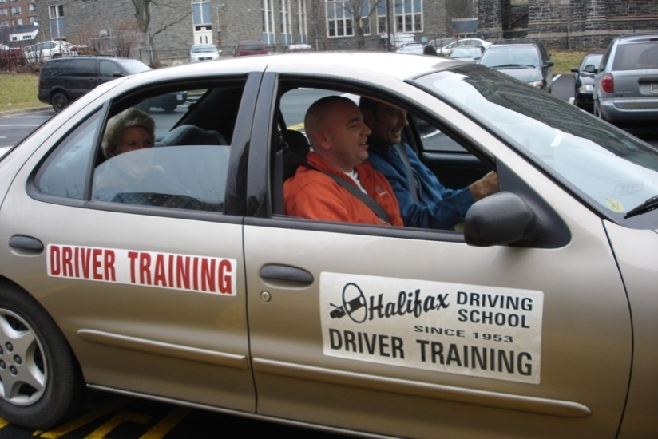
Driving
Suggest road safety refresher courses
Driving schools
Rehabilitation specialists

Slide 33
Driving
Advise on maintaining visibility
Clean windscreen, headlights and spectacles
Sunglasses
Not in dim or dark conditions
Drive during daylight
Limit driving at night, poor weather, glare

Slide 34
Driving
Advise on avoiding risky situations
Rush hour
Highway driving
Take care with right turns (left side of road driving)
Minimise distractions
Phones, passengers, radio

Slide 35
Driving
Advise on avoiding risky situations
Beware of pedestrians, bicycles and other vehicles

Slide 36
Driving
Advise on finding a safe way
Planning ahead; auto-navigation systems
Roads with clear signs and lane markings
Right turns at controlled intersections
Easy parking
Advise on driving a safe car
Comfortable size and fit
Maximum visibility
Minimum physical strain (auto transmission, power steering)
Top condition

Slide 37
Driving
Advise on keeping fit
Exercise body and mind to maintain alertness
Advise on medications
Review all (including OTC meds)
Advise on full medical work-up
Consult GP

Slide 38
Driving
Advise on other options
Public transport
Eligibility for transportation benefits

Slide 39
Mental Health
Psychological burden and depression are imposed in
patients of glaucoma due to the limitation of spaces
(limitation of driving*,**, fear of falling^ and
worse balance^^)
The way patients perceived their vision has affacted
QoL more than their objective vision measurements
(Jampel et al. Am J Ophthalmol, 2007;144:238-44)
*Ramulu et al, Ophthalmology 2009;116:11846-53
**Campbell et al. J Gerontol 1993; 48:S230-4
^Freeman et al. Invest Ophthalmol Vis Sci 2007; 48:4445-50
^^Popescu et al. Invest Ophthalmol Vis Sci 2021;53:2308=13

Slide 40
Medication adherence
Patient perspective
“But I see fine!”
“Therapy doesn’t make me feel better”
“I have side effects”
“Why do I need so many tests, so often?”
“All this is very expensive”

Slide 41
Medication adherence
Management concerns
Adherence
Persistence
Dyscompliance
As stated by former Surgeon General C. Everett Koop:
“Drugs don’t work in patients who don’t take them.”
Osterberg L, Blaschke T. N Engl J Med 2005; 353: 487–97.
Notes:
Reference
Osterberg L, Blaschke T. Adherence to medication. N Engl J Med 2005; 353: 487–97.

Slide 42
Medication adherence
Compliance
The extent to which the patient’s behaviour (drugs, diets, lifestyle changes) coincides with the clinical prescription
Non-compliance
Intentional or accidental failure to comply with a physician’s express or implied directions in the self-administration of any treatment
Notes:
The key features of two early definitions of medication compliance and non-compliance are shown. These are summarised from the following published quotes:
Compliance may be defined as "the extent to which the patient's behaviour (in terms of taking medications, following diets or executing other lifestyle changes) coincides with the clinical prescription".¹
Non-compliance may be defined as “failure to comply (intentional or accidental) with the physician's directions (expressed or implied) in the self-administration of any medication”.²
References
1. Sackett DL. The magnitude of compliance and noncompliance. In: Sackett DL, Haynes RB, eds. Compliance with therapeutic regimens. Baltimore and London: The Johns Hopkins University Press, 1976: 9.
2. Boyd JR, Covington TR, Stanaszek WF, Coussons RT. Drug defaulting. II. Analysis of noncompliance patterns. Am J Health Syst Pharm 1974; 31: 485–91.

Slide 43
Medication adherence
Non-adherence
Unintentional
Passive process (e.g. forgetting)
Intentional
Deliberate decision not to adhere
Intentional
Deliberate decision not to adhere

Slide 44
Medication adherence
Persistence
Cumulative time from initiation to discontinuation of a course of therapy
Dyscompliance
Technical difficulty in the self-administration of any medication (inhaled bronchodilators, insulin injections, topical eye drops)

Slide 45
Medication adherence
Condition | Medication adherence
HIV | 88%
Arthritis | 81%
GI disorders | 80%
Cancer | 79%
Seizures / brain disorders | 78%
GU / STDs | 77%
Skin disorders | 77%
Cardiovascular disease | 77%
ENT | 76%
Blood disorders | 76%
O & G | 75%
Infectious diseases | 74%
Eye disorders | 73%
Pulmonary disorders | 69%
Diabetes | 68%
Sleep disorders | 66%
DiMatteo MR. Med Care 2004; 42: 200–9.
Notes:
Reference
DiMatteo MR. Variations in patients' adherence to medical recommendations: a quantitative review of 50 years of research. Med Care 2004; 42: 200–9.

Slide 46
Medication adherence
Prevalence
45% of glaucoma patients reported some degree of non-adherence¹
Of these, a third reported intentional non-adherence¹
Similarly, 45% of glaucoma patients using an electronic monitoring device and provided with free medication used their drops less than 75% of the time²
1. Rees G et al. Ophthalmology 2010; 117: 903–8; 2. Okeke CO et al. Ophthalmology 2009; 116: 191–9.
1. Rees G et al. Ophthalmology 2010; 117: 903–8; 2. Okeke CO et al. Ophthalmology 2009; 116: 191–9.
Notes:
References
1. Rees G, Leong O, Crowston JG, Lamoureux EL. Intentional and unintentional nonadherence to ocular hypotensive treatment in patients with glaucoma. Ophthalmology 2010; 117: 903–8.
2. Okeke CO, Quigley HA, Jampel HD et al. Adherence with topical glaucoma medication monitored electronically the Travatan Dosing Aid study. Ophthalmology 2009; 116: 191–9.

Slide 47
Medication adherence
Patel SC, Spaeth GL. Ophthalmic Surg 1995; 26: 233–6.
Patel SC, Spaeth GL. Ophthalmic Surg 1995; 26: 233–6.
Notes:
Reference
Patel SC, Spaeth GL. Compliance in patients prescribed eyedrops for glaucoma. Ophthalmic Surg 1995; 26: 233–6.

Slide 48
Medication adherence
In Australian patients (n=131)
45% non-adherence rate:
66% unintentional
17% intentional
17% both intentional and unintentional
Non-adherers were significantly younger, less likely to use other medications and held lower belief in the necessity of eye drops for glaucoma (p<0.05)
Unintentional non-adherence was associated with lower belief in necessity of eye drops (p<0.05)
Intentional non-adherence was associated with concerns about eye drops (p<0.05)
Rees G et al. Ophthalmology 2010; 117: 903–8.
Notes:
Reference
Rees G, Leong O, Crowston JG, Lamoureux EL. Intentional and unintentional nonadherence to ocular hypotensive treatment in patients with glaucoma. Ophthalmology 2010; 117: 903–8.

Slide 49
Medication adherence
Reasons and risk factors
Can clinicians tell who does and who does not adhere or persist?
They overestimate, assuming a higher rate of adherence than is actually present^{1–3}
As a result of physician-centred communication during consultations, clinicians fail to identify most patients who miss doses⁴
1. Caron HS, Roth HP. JAMA 1968; 203: 922–6; 2. Roth HP, Caron HS. Clin Pharmacol Ther 1978; 23: 361–70; 3. Kass MA et al. Am J Ophthalmol 1986; 101: 524–30 ; 4. Friedman DS et al. Ophthalmology 2009; 116: 2277-85.e1–3.
Notes:
References
1. Caron HS, Roth HP. Patients' cooperation with a medical regimen. Difficulties in identifying the noncooperator. JAMA 1968; 203: 922–6.
2. Roth HP, Caron HS. Accuracy of doctors' estimates and patients' statements on adherence to a drug regimen. Clin Pharmacol Ther 1978; 23: 361–70.
2. Kass MA, Gordon M, Meltzer DW. Can ophthalmologists correctly identify patients defaulting from pilocarpine therapy? Am J Ophthalmol 1986; 101: 524–30.
4. Friedman DS, Hahn SR, Quigley HA et al. Doctor-patient communication in glaucoma care: analysis of videotaped encounters in community-based office practice. Ophthalmology 2009; 116: 2277-85.e1–3.

Slide 50
Medication adherence
Clinician estimate versus objective estimate of adherence
Overestimates
Adherence – clinician estimate
0% 10% 20% 30% 40% 50% 60% 70% 80% 90% 100%
Underestimates
0% 10% 20% 30% 40% 50% 60% 70% 80% 90% 100%
Adherence – MEMS
MEMS, Medication Event Monitoring System
Caron and Roth, Am J Med Sci.1971 [[TBC]]

Slide 51
Medication adherence
Reasons and risk factors
What factors contribute to the failure to adhere to, or persist with, glaucoma medications?

Slide 52
Medication adherence
Reasons and risk factors
Disease
Asymptomatic, chronic
Treatment regimen
Intrusive, affecting quality of life
Dyscompliance problems
Side effects – alarming, unexpected
Long-term costs
Perceived lack of efficacy
Frequency

Slide 53
Medication adherence
Reasons and risk factors
Patient factors
-Forgetting
-Knowledge – understanding disease, Rx goals
-Perceived disease severity
-Family support (assisting with reminders, instillation, driving to appointments)
-Comorbidity
-Major life events
-Travel/away from home
-Competing activities
-Change in routine
-Resources – financial, support
-White coat adherence (increases week before appointment and declines following)
Major life events
Travel/away from home
Competing activities
Change in routine
Resources – financial, support
White coat adherence (increases week before appointment and declines following)

Slide 54
Medication adherence
Reasons and risk factors
Care delivery setting
Waiting times for appointments
Waiting times at appointments
Doctor – reduced availability, less supportive attitude

Slide 55
Medication adherence
Reasons and risk factors
Communication
“…medical decision making: determining the patient’s best interest. The easy way is the paternalistic approach; we know what is “best” for our patients. But do we really know their perspective?”¹
Analysis of 50 consultations with glaucoma patients revealed 94% of clinician questions were closed-ended, and no questions were asked about patients’ understanding of the purpose of their medication²
1. Brubaker RF. Ophthalmology 1999; 106: 165–8; 2. Friedman DS et al. Ophthalmology 2009; 116: 2277-85.e1–3.
Notes:
References
1. Brubaker RF. Decisions, decisions. Ophthalmology 1999; 106: 165–8.
2. Friedman DS, Hahn SR, Quigley HA et al. Doctor-patient communication in glaucoma care: analysis of videotaped encounters in community-based office practice. Ophthalmology 2009; 116: 2277-85.e1–3.

Slide 56
Medication adherence
Reasons and risk factors
Do different ways of measuring non-adherence give different results?

Slide 57
Medication adherence
Kass MA et al. Am J Ophthalmol 1987; 103: 188–93.
Notes:
Reference
Kass MA, Gordon M, Morley RE Jr, Meltzer DW, Goldberg JJ. Compliance with topical timolol treatment. Am J Ophthalmol 1987; 103: 188–93.

Slide 58
Medication adherence
Reasons and risk factors
Are there consequences?
Skipping doses may lead to increased IOP fluctuations

Slide 59
Medication adherence
Patient report versus drop monitor estimate of adherence
Peak-to-trough IOP fluctuation after 2 weeks of treatment with travoprost, before and after a missed dose
18.0
24 hours
before
24 hours
after
Scheduled dose administered
(N=21)
17.0
16.0
Scheduled dose not administered
15.0
Mean IOP (mm Hg) at day 29
3.1 mm Hg
fluctuation
4.6 mm Hg
fluctuation
14.0
13.0
12.0
0
(8pm)
4
(12mn)
8
(4am)
12
(8am)
16
(12noon)
20
(4pm)
24
(8pm)
28
(12mn)
32
(4am)
36
(8am)
40
(12noon)
44
(4pm)
Hours after last 8 pm dose of 2-week study (time of day)
Dubiner HB et al. Clin Ther 2004; 26: 84–91.
Notes:
Reference
Dubiner HB, Sircy MD, Landry T et al. Comparison of the diurnal ocular hypotensive efficacy of travoprost and latanoprost over a 44-hour period in patients with elevated intraocular pressure. Clin Ther 2004; 26: 84–91.

Slide 60
Medication adherence
Reasons and risk factors
Patients generally do not do what they are supposed to do
Patients will not tell you reliably that they are not doing what they are supposed to be doing
They don’t want to disappoint you
“How can you expect me to remember what I have forgotten to do?”

Slide 61
Medication adherence
Reasons and risk factors
Dyscompliance/physical difficulties
Break seal
Open bottle
Tilt back head
Raise arm above shoulder height
Hold bottle steady
Express drop
Drop into sac
Avoid tip / eye contact
Avoid blinking
Nasolacrimal duct compression

Slide 62
Medication adherence
Reasons and risk factors
Dyscompliance/instillation techniques
45% of n=148 tip-top
35% rammers
15% high-altitude bombers
Kass MA et al. Am J Ophthalmol 1987; 103: 188–93.

Slide 63
Medication adherence
Reasons and risk factors
Dyscompliance/instillation success
25% did not succeed
13% did not know they failed
15% could not express a drop at all
Kass MA et al. Am J Ophthalmol 1987; 103: 188–93.
Notes:
Reference (TBC)
Kass MA, Gordon M, Morley RE Jr, Meltzer DW, Goldberg JJ. Compliance with topical timolol treatment. Am J Ophthalmol 1987; 103: 188–93.

Slide 64
Medication adherence
Improving adherence – interventions
Ask them about adherence!
Shared decision-making and open-ended questions¹
Minimise drug treatment
Number
Concentration
Frequency of instillation
Double DOT
1. Hahn SR. Ophthalmology 2009; 116 (11 Suppl): S37–42.
1. Hahn SR. Ophthalmology 2009; 116 (11 Suppl): S37–42.
Notes:
Reference
Hahn SR. Patient-centered communication to assess and enhance patient adherence to glaucoma medication. Ophthalmology 2009; 116 (11 Suppl): S37–42.

Slide 65
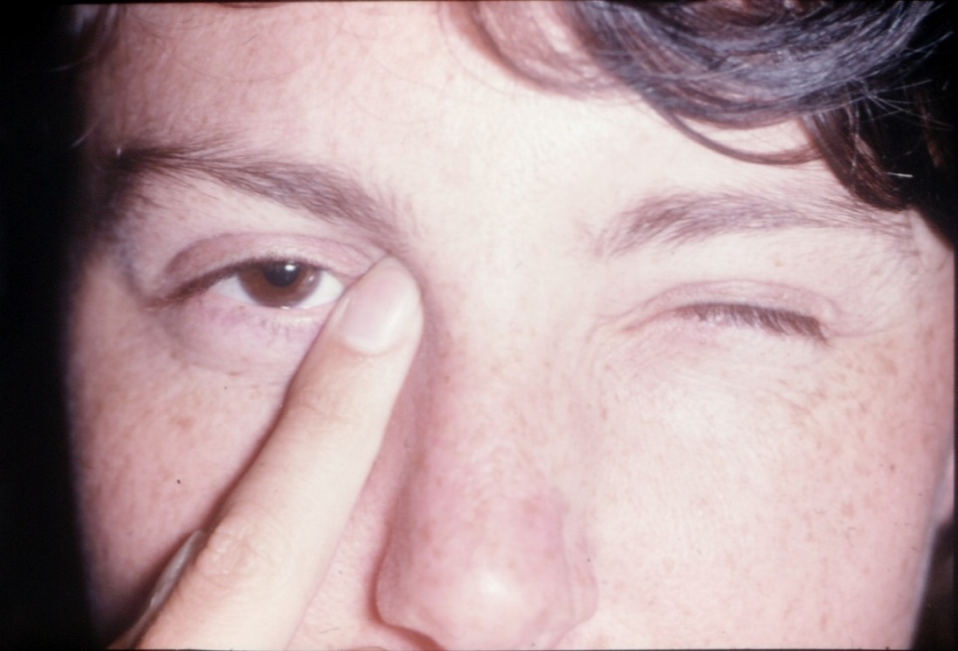
Medication adherence
Improving adherence – interventions
The double DOT
Digital Occlusion of the Tear duct
Don’t Open Technique
Digital Occlusion of the Tear duct
Don’t Open Technique
Reduce systemic concentration by two-thirds
Reduce systemic concentration by two-thirds
Zimmerman TJ et al. Arch Ophthalmol 1984; 102: 551–3.
Notes:
Reference
Zimmerman TJ, Kooner KS, Kandarakis AS, Ziegler LP. Improving the therapeutic index of topically applied ocular drugs. Arch Ophthalmol 1984; 102: 551–3.

Slide 66
Medication adherence
Improving adherence – interventions
Maximise patient understanding
Ensure patient has realistic expectations
Provide information
Communicate and educate
Elicit and address patient’s beliefs about the necessity of medication and their concerns about it
In-office glaucoma educator

Slide 67
Medication adherence
Improving adherence – interventions
Maximise support
Establish and develop therapeutic alliance with patient and, if they wish, their family and carers
Patient support organisations
Internet resources
Reminder and recall systems
Phone, email
Bottle devices with dosing support
Follow-up

Slide 68
Ocular Surface Diseases
Impact of OSD and QoL was assessed using GQL-15 and Ocular Surface Disease Index (OSDI) questionnaires. OSDI provides a rapid assessment of OSD related to chronic dry eye, its severity and its impact on patient's ability to function.
OSDI scores correlated well with severity of glaucoma n patients < 60 yo and 70-79 yo subgroup
Exposure to >3 BAK-preserved eyedrops per day was independently predictive of OSD in multivariate analysis (p= 0.018)
Skalicky SE et al. Am J Ophthalmol 2012; 153(1-9):e3
Skalicky SE et al. Am J Ophthalmol 2012; 153(1-9):e3

Slide 69
Cost burden
Glaucoma is costly, and costs increase with severity
Patients with ocular hypertension have mean annual eye-related direct medical costs of US$623, rising to $2511 for those with end-stage disease¹
Most charges are not pharmacy-related²
1. Lee PP et al. Arch Ophthalmol 2006; 124: 12–9; 2. Lee PP et al. Ophthalmology 2007; 114: 1241–7.
Notes:
References
1. Lee PP, Walt JG, Doyle JJ et al. A multicenter, retrospective pilot study of resource use and costs associated with severity of disease in glaucoma. Arch Ophthalmol 2006; 124: 12–9.
2. Lee PP, Levin LA, Walt JG et al. Cost of patients with primary open-angle glaucoma: a retrospective study of commercial insurance claims data. Ophthalmology 2007; 114: 1241–7.

Slide 70
Cost burden
* Outpatient prescription medications not included.
Bramley T et al. Arch Ophthalmol 2008; 126: 849–56.
Notes:
The effect of vision loss on healthcare costs was assessed in nearly 182,000 Medicare beneficiaries with glaucoma. Mean total and component costs increased with vision loss; this increase was driven primarily by the cost of inpatient visits (52.5% to 69.4% of total costs), including nursing home placement. Outpatient prescription medications were excluded as they were not covered by Medicare at the time of the study. Costs were reported in 2007 US dollars.
Reference
Bramley T, Peeples P, Walt JG, Juhasz M, Hansen JE. Impact of vision loss on costs and outcomes in Medicare beneficiaries with glaucoma. Arch Ophthalmol 2008; 126: 849–56.

Slide 71
Low vision services
Optimisation of residual vision and improved QOL Barriers¹
Awareness – patient not knowing about it!
Assuming “nothing more can be done”
Transport
Affordability
Timely referral
Communication and trust between patient and ophthalmologist
Time constraints of ophthalmologist
1. Chiang PPC et al. Expert Rev Ophthalmol 2007; 2: 861–874.
Notes:
Reference
Chiang PPC, O’Connor PM, Keeffe JE. Low vision service provision: a global perspective. Expert Rev Ophthalmol 2007; 2: 861–874.

Slide 72
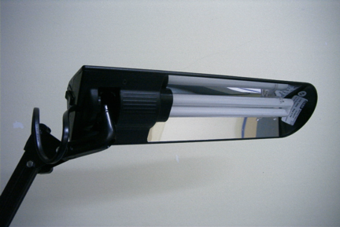
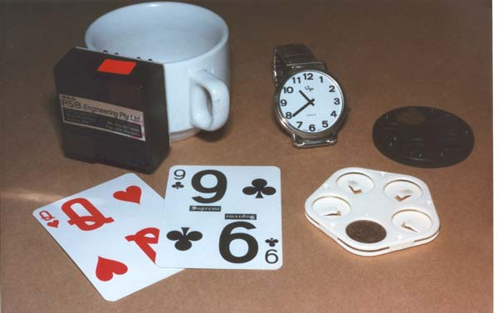
Low vision services
Provide low vision care or refer to agency
Establish patient goals
Lighting and contrast
Energy-efficient cool fluorescent lights
Position close to task

Slide 73
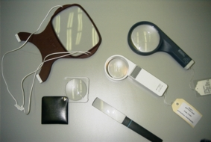
Low vision services
Devices
Magnifiers and telescopes can be problematic because of reduced visual fields
Where VA is reduced, consider high addition spectacles for near tasks, perhaps a low power, hand-held magnifier and low power distance telescope

Slide 74
Low vision services
Technology
Where VA is reduced, use large, bold computer display settings or voice output
iPad
CCTV reading machines
Orientation and mobility training
Symbol/identification cane; long cane

Slide 75
Low vision services
Financial support
Pension eligibility
Travel and taxi concessions
Psychosocial support
Welfare officers
Peers
Consumer organisations

Slide 76
APPENDIX
GQL-15 QUESTIONNAIRE

Slide 77
GQL-15 questionnaire
One summary score
Sum of item-level responses

Slide 78
GQL-15 questionnaire
Instructions
“Does your vision give you any difficulty, even with glasses, with the following activities?
(Circle one number)
[1] no difficulty
[2] little bit of difficulty
[3] some difficulty
[4] quite a lot of difficulty
[5] severe difficulty
[0] you do not perform the activity for reasons other than visual

Slide 79
GQL-15 questionnaire
 | None | A little bit | Some | Quite a lot | Severe | Not performed for non-visual reasons
1. Reading newspapers | 1 | 2 | 3 | 4 | 5 | 0
2. Walking after dark | 1 | 2 | 3 | 4 | 5 | 0
3. Seeing at night | 1 | 2 | 3 | 4 | 5 | 0
4. Walking on uneven ground | 1 | 2 | 3 | 4 | 5 | 0
5. Adjusting to bright lights | 1 | 2 | 3 | 4 | 5 | 0
6. Adjusting to dim lights | 1 | 2 | 3 | 4 | 5 | 0
7. Going from light to dark: vice versa | 1 | 2 | 3 | 4 | 5 | 0
8. Tripping over objects | 1 | 2 | 3 | 4 | 5 | 0
9. Seeing objects coming from the side | 1 | 2 | 3 | 4 | 5 | 0
10. Crossing the road | 1 | 2 | 3 | 4 | 5 | 0
11. Walking on steps/stairs | 1 | 2 | 3 | 4 | 5 | 0
12. Bumping into objects | 1 | 2 | 3 | 4 | 5 | 0
13. Judging distances of foot to step | 1 | 2 | 3 | 4 | 5 | 0
14. Finding dropped objects | 1 | 2 | 3 | 4 | 5 | 0
15. Recognizing faces | 1 | 2 | 3 | 4 | 5 | 0

Slide 80
GQL-15 questionnaire
Subscale scores
0 (no difficulty) → 100 (severe difficulty)
Summary scores
1 (no difficulty) → 5 (severe difficulty)

Slide 81
GQL-15 questionnaire
GQL-15
Glaucoma patients reported greater difficulty in vision-related function than controls (mean summary scores = 30.5 vs. 18.5, respectively; p<0.001)
Significant differences in mean ranks of summary scores between patients with mild, moderate and severe glaucoma
Correlated with perimetric MD (r = –0.60)
Nelson P et al. J Glaucoma 2003; 12: 139–50.
Notes:
Reference
Nelson P, Aspinall P, Papasouliotis O, Worton B, O'Brien C. Quality of life in glaucoma and its relationship with visual function. J Glaucoma 2003; 12: 139–50.

Slide 82
GQL-15 questionnaire
GQL-15 summary scores for 121 glaucoma patients
classified by the Nelson Glaucoma Staging System (GSS)
 | Mild | Moderate | Severe | P*
Mean GQL-15 score (SD) | 21.7 (8.6) | 29.6 (10.7) | 40.0 (14.8) | <0.001
Mild versus moderate | – | – | – | 0.007
Mild versus severe | – | – | – | <0.001
Moderate versus severe | – | – | – | 0.002
* Kruskal-Wallis and post-hoc Mann Whitney U test
Goldberg I et al. J Glaucoma 2009; 18: 6–12.

Slide 83
GQL-15 questionnaire
GQL-15 subscale scores
Subscale | Glaucoma patients N=121 Mean (SD) | Control subjects N=31 Mean (SD) | P*
Central/near vision | 21.2 (24.7) | 3.2 (6.4) | all <0.001
Peripheral vision | 24.6 (24.6) | 4.7 (9.4)
Glare/dark adaptation | 32.0 (26.7) | 8.5 (10.1)
Outdoor mobility | 18.6 (25.9) | 1.6 (6.2)
*Mann Whitney U test
Goldberg I et al. J Glaucoma 2009; 18: 6–12.
Notes:
Reference
Goldberg I, Clement CI, Chiang TH et al. Assessing quality of life in patients with glaucoma using the Glaucoma Quality of Life-15 (GQL-15) questionnaire. J Glaucoma 2009; 18: 6–12.

Slide 84
GQL-15 questionnaire
Mean GQL-15 Subscale Scores by Disease Severity (Nelson GSS)
80
70
60
50
Mean Subscale
*
Control
Score + SD
40
*
Mild
30
*
*
Moderate
Mean Subscale
*
Severe
20
*
*
10
*
*
*
*
0
Central and near
Peripheral vision
Glare, lighting,
Outdoor mobility
vision
dark adaptation
Factor
* Mann Whitney U-test significant at P<0.05 (compared to control group)
Goldberg I et al. J Glaucoma 2009; 18: 6–12.
Notes:
Reference
Goldberg I, Clement CI, Chiang TH et al. Assessing quality of life in patients with glaucoma using the Glaucoma Quality of Life-15 (GQL-15) questionnaire. J Glaucoma 2009; 18: 6–12.

Slide 85
THANK YOU

