Slide 1
Ex-PRESS insertion: what?
Stainless steel, non-valved mini implant
MRI compatible and biocompatible
In some respects, an easier and faster technique
No need for sclerectomy or iridectomy
Notes:
The Ex-PRESS™ Glaucoma Filtration Device [Alcon Laboratories, Fort Worth, TX, USA] is a miniature, non-valved stainless steel shunt that creates an outflow channel to drain aqueous humor from the anterior chamber to the intra-scleral space, forming a low, diffuse posterior bleb. The stainless steel is biocompatible (does not cause inflammation) and compatible with magnetic resonance imaging (MRI).
The technique for Ex-PRESS insertion is similar to standard trabeculectomy, but neither sclerectomy nor iridectomy is required.
Reference
Moster MR. Procedural treatments: Ex-PRESS mini glaucoma shunt. In: Giaconi JA, Law SK, Caprioli J (eds.) Pearls of Glaucoma Management. Berlin: Springer-Verlag; 2010. p. 307–315.

Slide 2
Ex-PRESS insertion: what?
Image courtesy of Alcon
Notes:
Available in several models, the Ex-PRESS device has an external shaft diameter of 400 μm and an inner diameter (axial lumen) of 50 μm or 200 μm. An external plate prevents excessive penetration and a spur prevents extrusion of the device. The R and P models have a rounded and beveled tip to facilitate insertion, while the P models have a vertical split in the external plate to promote posterior flow. The total device length is under 3 mm.
Reference
Moster MR. Procedural treatments: Ex-PRESS mini glaucoma shunt. In: Giaconi JA, Law SK, Caprioli J (eds.) Pearls of Glaucoma Management. Berlin: Springer-Verlag; 2010. p. 307–315.

Slide 3
Ex-PRESS insertion: why?
Creates a persistent channel to drain aqueous humor from the anterior chamber to the intra-scleral space
Less ocular inflammation and complications than trabeculectomy
Disadvantages include increased cost
Notes:
Theoretical advantages claimed for Ex-PRESS insertion over trabeculectomy include less inflammation because no peripheral iridectomy is required; a reduced risk of hypotony and shallow anterior chamber; and more uniform control of filtration.¹ The constant fistula size helps to reduce variation in flow, and the technique and postoperative course are repeatable and consistent.² In addition, the Ex-PRESS shunt may be able to be implanted in eyes with some conjunctival scarring.²
A randomized trial compared Ex-PRESS vs. trabeculectomy in 78 patients with POAG.^{3,4}
Mean IOP was significantly lower with Ex-PRESS during the first 3 years (12.0 vs. 13.5 mmHg at year 3).³
Ex-PRESS recipients were less likely to require IOP medications during the 5-year follow-up.⁴
Complications were similar in both groups.³ Early hypotony was common (16% Ex-PRESS, 22.5% trabeculectomy). Shallow anterior chamber occurred in 20% of the Ex-PRESS group vs. 12.5% of the trabeculectomy group.³ The high complication rate was attributed to viscoelastic not being used and a learning curve for Ex-PRESS implantation.³
A second randomized trial compared Ex-PRESS vs. trabeculectomy in fellow eyes of the same patient:⁵
Both procedures provided similar IOP control after a mean follow-up of 23.6 months.
Ex-PRESS recipients needed fewer glaucoma medications (p = 0.001), had a lower rate of complications (20% vs. 33%), and had fewer postoperative interventions (0 vs. 27%).
Potential disadvantages of the Ex-PRESS device include cost, trauma to ocular structures such as the iris or corneal endothelium, and the development of fibrosis over the device opening.¹
References
1. Francis BA, Singh K, Lin SC et al. Novel glaucoma procedures: a report by the American Academy of Ophthalmology. Ophthalmology 2011; 118: 1466–80.
2. Moster MR. Procedural treatments: Ex-PRESS mini glaucoma shunt. In: Giaconi JA, Law SK, Caprioli J (eds.) Pearls of Glaucoma Management. Berlin: Springer-Verlag; 2010. p. 307–315.
3. de Jong LA. The Ex-PRESS glaucoma shunt versus trabeculectomy in open-angle glaucoma: a prospective randomized study. Adv Ther 2009; 26: 336–45.
4. de Jong L, Lafuma A, Aguadé AS, Berdeaux G. Five-year extension of a clinical trial comparing the EX-PRESS glaucoma filtration device and trabeculectomy in primary open-angle glaucoma. Clin Ophthalmol 2011; 5: 527–33.
5. Dahan E, Ben Simon GJ, Lafuma A. Comparison of trabeculectomy and Ex-PRESS implantation in fellow eyes of the same patient: a prospective, randomised study. Eye (Lond). 2012; 26: 703–10.

Slide 4
Ex-PRESS insertion: when?
As for trabeculectomy
Suitable for combined cataract and glaucoma surgery
Not suitable in angle-closure patients
Notes:
Ex-PRESS insertion may be used in open-angle glaucoma refractory to medical and laser treatment, or after the failure of a prior trabeculectomy.¹ When used as part of combined cataract and glaucoma surgery, visual recovery may be faster following Ex-PRESS insertion compared with trabeculectomy.¹ In eyes with aphakic glaucoma, the lack of requirement for iridectomy with Ex-PRESS implantation is potentially advantageous as there may be less risk of vitreous moving forward.¹
The Ex-PRESS shunt is contra-indicated in patients with angle closure, uveitis, ocular infection, severe dry eye, or severe blepharitis.²
References
1. Moster MR. Procedural treatments: Ex-PRESS mini glaucoma shunt. In: Giaconi JA, Law SK, Caprioli J (eds.) Pearls of Glaucoma Management. Berlin: Springer-Verlag; 2010. p. 307–315.
2. Alcon Laboratories. Important Safety Information for Surgical Glaucoma: EX-PRESS® Glaucoma Filtration Device. Available at: www.alconsurgical.com/ISI_Surgical-Glaucoma.aspx. Accessed 2 July 2012.

Slide 5
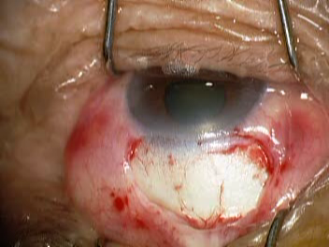
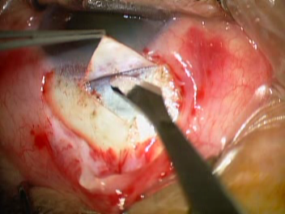
Ex-PRESS insertion: how? (1)
Conjunctival flap
Scleral flap
Photos courtesy of Da-wen Lu
Notes:
The procedure for Ex-PRESS insertion is similar to a standard trabeculectomy.¹ A fornix- or limbus-based conjunctival flap is made and a partial-thickness scleral flap is dissected (extrusion proved to be a problem when the device was implanted under the conjunctiva, thus implantation beneath a scleral flap is now standard).¹ The scleral flap may need to be slightly larger than for a standard trabeculectomy, in order to fully cover the external plate of the device.² A triangular flap is shown; other surgeons may prefer a rectangular flap.
Use of adjunctive agents such as MMC is also similar to trabeculectomy.¹
References
1. Francis BA, Singh K, Lin SC et al. Novel glaucoma procedures: a report by the American Academy of Ophthalmology. Ophthalmology 2011; 118: 1466–80.
2. Tam DY, Ahmed IK. Incisional therapies: canaloplasty and new implant devices. In: Schacknow PN, Samples JR (eds.) The Glaucoma Book: A Practical, Evidence-Based Approach to Patient Care. New York: Springer; 2010. p. 795–812.

Slide 6
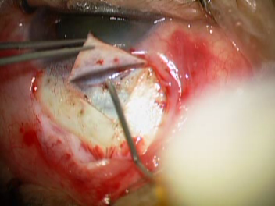
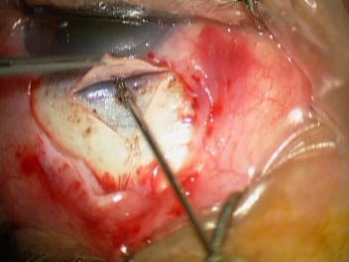
Ex-PRESS insertion: how? (2)
Needle puncture*
Device insertion
* 25G or 27G, depending on Ex-PRESS model.
Photos courtesy of Da-wen Lu
Notes:
The anterior chamber is inflated using viscoelastic or air.¹ An opening to the anterior chamber is created using either a needle (27-gauge for the R50 model, 25G for the P50/P200 models, and 23–25G for the X50/X200 models),² or a sapphire/diamond blade.³ Identification of the scleral spur is vital to ensure correct placement of the shunt.¹ The opening is made at the junction of the cornea and sclera (grey line), and the needle entry is directed parallel to the iris and posterior to the cornea.²
Using a preloaded injector, the device is then introduced through the previously created needle track entry into the mid-anterior chamber, flush with the sclera, and released.^{1,2} If the device is correctly positioned, an immediate flow should be observed through the 50-μm lumen.²
References
1. Tam DY, Ahmed IK. Incisional therapies: canaloplasty and new implant devices. In: Schacknow PN, Samples JR (eds.) The Glaucoma Book: A Practical, Evidence-Based Approach to Patient Care. New York: Springer; 2010. p. 795–812.
2. Moster MR. Procedural treatments: Ex-PRESS mini glaucoma shunt. In: Giaconi JA, Law SK, Caprioli J (eds.) Pearls of Glaucoma Management. Berlin: Springer-Verlag; 2010. p. 307–315.
3. Francis BA, Singh K, Lin SC et al. Novel glaucoma procedures: a report by the American Academy of Ophthalmology. Ophthalmology 2011; 118: 1466–80.

Slide 7
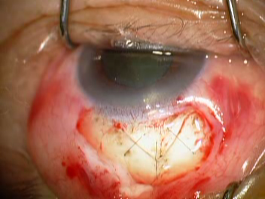
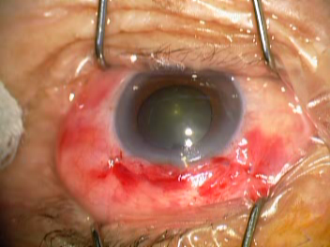
Ex-PRESS insertion: how? (3)
Scleral flap closure
Conjunctival closure
Photos courtesy of Da-wen Lu
Notes:
Closure of the scleral and conjunctival flaps are performed as in a standard trabeculectomy, and similar adjunctive procedures may be needed postoperatively.¹ To allow for posterior flow of aqueous, anterior placement of one or two sutures on the scleral flap is recommended.² Watertight closure is necessary once satisfactory flow has been achieved;¹ particular care is needed when using a fornix-based flap, as failure is likely if there is leakage at the limbus.²
Where the initial IOP is above 25–30 mmHg, a low molecular weight sodium hyaluronate should be used to prevent hypotony.²
References
1. Tam DY, Ahmed IK. Incisional therapies: canaloplasty and new implant devices. In: Schacknow PN, Samples JR (eds.) The Glaucoma Book: A Practical, Evidence-Based Approach to Patient Care. New York: Springer; 2010. p. 795–812.
2. Moster MR. Procedural treatments: Ex-PRESS mini glaucoma shunt. In: Giaconi JA, Law SK, Caprioli J (eds.) Pearls of Glaucoma Management. Berlin: Springer-Verlag; 2010. p. 307–315.

Slide 8
Video: Ex-PRESS insertion
Video courtesy of L. Vijaya
Notes:
This video demonstrating insertion of the Ex-PRESS glaucoma filtration device was provided by Dr L Vijaya (Director, Smt Jadhavabai Nathmal Singhvee Glaucoma Services, Sankara Nethralaya, Chennai, India).
The following steps are shown:
creation of a fornix-based conjunctival flap in the superior nasal quadrant
administration of sub-Tenon's anaesthesia
gentle cauterisation of bleeders
measurement, incision and dissection of a 5 × 5 mm scleral flap
entry into the anterior chamber at the grey line with a 25-gauge needle
insertion of the Ex-PRESS device
checking the flow with fluorescent dye
closure of the scleral flap using 10-0 nylon with two interrupted sutures and one releasable suture (optional)
closure of the conjunctiva with 10-0 vicryl suture and trimming of the releasable suture
formation of the anterior chamber.

Slide 9
Ex-PRESS insertion
Courtesy of Dr Rouwen

Slide 10
Minimally invasive glaucoma surgeries

Slide 11
Minimally invasive glaucoma surgeries: what?
Ab interno, micro-incisional approach
Spares conjunctival tissue
Minimal trauma to target tissue
Less effective than trabeculectomy or tube shunts
Very good safety profile, rapid recovery
Enhance trabecular or uveoscleral outflow
Saheb H, Ahmed IK. Curr Opin Ophthalmol 2012; 23: 96–104.
Notes:
Minimally invasive glaucoma surgeries share several features, including an ab interno, micro-incisional approach that spares the conjunctiva, helps to maintain the anterior chamber during the procedure, retains the normal ocular anatomy, and minimizes changes in refractive outcomes. These procedures minimise trauma to the target tissue. Desirable features include biocompatibility of implanted devices and enhancement of physiologic outflow (trabecular outflow via Schlemm’s canal, or uveoscleral outflow).
The safety profile of minimally invasive surgeries is excellent and patient recovery is rapid, which is important as efficacy is typically modest compared with more invasive options such as trabeculectomy with mitomycin C and glaucoma drainage devices; patients who require a very low unmedicated postoperative IOP and those with very advanced disease may be unsuitable candidates. Randomized trials and cost-effectiveness studies are needed.
The operative technique requires direct gonioscopy, intra-operative manipulation of the microscope and the patient’s head, and for some surgeons, a new angle of approach. Minimally invasive glaucoma surgeries can readily be incorporated into other procedures, notably cataract extraction.
Reference
Saheb H, Ahmed IK. Micro-invasive glaucoma surgery: current perspectives and future directions. Curr Opin Ophthalmol 2012; 23: 96–104. [p97-8, 102]

Slide 12
Trabecular meshwork bypass: what?
Types of trabecular meshwork bypass
Trabectome®
Glaukos iStent® insertion
Ivantis Hydrus™ insertion
Re-establishes the natural drainage pathway
Indicated for open-angle glaucoma
Notes:
Trabecular meshwork (TM) bypass procedures increase outflow by augmenting the conventional (trabecular) outflow pathway.
Trabectome® and trabecular micro-bypass stents are covered in this section. Canaloplasty may also be categorized as a TM bypass procedure. Excimer laser trabeculotomy (ELT) is a rarely used alternative that employs a xenon chloride excimer laser to make small holes in the TM and the inner wall of Schlemm’s canal, creating a pathway for aqueous to access Schlemm’s canal and nearby outflow collector channels.
Reference
Francis BA, Singh K, Lin SC et al. Novel glaucoma procedures: a report by the American Academy of Ophthalmology. Ophthalmology 2011; 118: 1466–80. [p1467]

Slide 13
Trabecular meshwork bypass: why?
Bypasses the most resistant site of physiological aqueous humor flow – the trabecular meshwork
Eliminates the need for a bleb
Easier surgical technique when combined with lens extraction
Notes:
The juxtacanalicular tissue of the TM and the inner wall of Schlemm’s canal are believed to be the site of greatest resistance to aqueous outflow.¹ In addition to eliminating this barrier, TM bypass procedures remove the need for an external filtering bleb.² The treatment aim is to lower IOP and reduce the need for glaucoma medications while avoiding the complications of filtering surgery (e.g. hypotony and bleb-related problems); these procedures are generally not expected to match the IOP-lowering efficacy of trabeculectomy with antimetabolites.²
References
1. Tam DY, Ahmed IK. Incisional therapies: canaloplasty and new implant devices. In: Schacknow PN, Samples JR (eds.) The Glaucoma Book: A Practical, Evidence-Based Approach to Patient Care. New York: Springer; 2010. p. 795–812. [p805]
2. Francis BA, Singh K, Lin SC et al. Novel glaucoma procedures: a report by the American Academy of Ophthalmology. Ophthalmology 2011; 118: 1466–80. [p1467]

Slide 14
Trabecular meshwork bypass: how?
Trabectome®
Ablation of the trabecular meshwork by electrocautery
Glaukos iStent®
Insertion of a micro-titanium L-type drainage tube in the trabecular meshwork
Ivantis Hydrus™
Ab interno insertion of a biocompatible alloy micro-stent into Schlemm's canal
Notes:
The Trabectome® [NeoMedix Corp., Tustin, CA, USA] is a device used to remove a portion of the TM and the inner layer of Schlemm’s canal by electrocautery, enabling increased outflow.¹ The procedure may be classified as an ab interno trabeculotomy.¹
The iStent® [Glaukos Corp., Laguna Hills, CA, USA] and Hydrus™ [Ivantis, Inc., Irvine, CA, USA] micro-stents are an alternative approach to bypassing the TM.²
Both Trabectome and iStent typically result in sustained IOP reduction to the mid-teens and have low complication rates.³ As such, these techniques are best suited to early and some moderate glaucomas.³ Both techniques spare the conjunctival tissue, allowing for future filtering surgery with or without implants.³
References
1. Liu J, Jung J, Francis BA. Ab interno trabeculotomy: Trabectome™ surgical treatment for open-angle glaucoma. Expert Rev Ophthalmol 2009; 4: 119–128.
2. Saheb H, Ahmed IK. Micro-invasive glaucoma surgery: current perspectives and future directions. Curr Opin Ophthalmol 2012; 23: 96–104.
3. Hill RA, Minckler DS. Incisional therapies: what’s on the horizon? In: Schacknow PN, Samples JR (eds.) The Glaucoma Book: A Practical, Evidence-Based Approach to Patient Care. New York: Springer; 2010. p. 831–840. [p834]

Slide 15
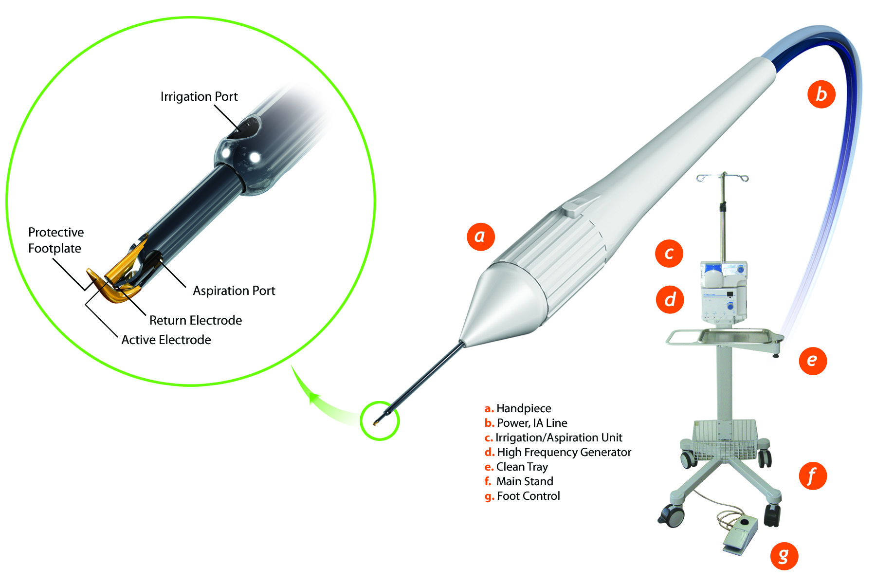
Trabectome: what?
Image courtesy of NeoMedix
Notes:
The components of the Trabectome device are a mobile stand with a bottle of basic salt solution, a single-use handpiece that incorporates a high-frequency electrocautery generator and a unit for irrigation of the anterior chamber and aspiration of ablated tissue; a foot pedal activates the irrigation, aspiration and electrocautery power in a stepwise manner.^{1,2} An insulated triangular footplate guides the anatomical placement of the tip in Schlemm’s canal and protects surrounding tissue from heat damage.²
Theoretical advantages of the Trabectome procedure include creation of a large pathway enabling aqueous flow from the anterior chamber to the collector channels with minimal damage to nearby structures, sparing of the conjunctiva, no bleb formation, and ease of combination with cataract surgery.³ Disadvantages may include lack of circumferential flow in Schlemm’s canal (restricting outflow to the collector channels), potential for cleft closure, and limitation of IOP reduction due to episcleral venous pressure and resistance in Schlemm’s canal.³
A retrospective case series of 1127 Trabectome procedures (738 Trabectome only, 366 Trabectome-phacoemulsification) has been reported.⁴ After 24 months, mean IOP decreased by 40% for Trabectome-only cases (from 25.7 to 16.6 mmHg) and by 18% for Trabectome-phacoemulsification cases (from 20.0 to 15.9 mmHg); however, the number of patients with long-term follow-up was small.⁴ Intraoperative blood reflux occurred in 78% of eyes, generally clearing within a few days.⁴
A recent review of Trabectome studies noted that cataract surgery with trabeculectomy lowered IOP significantly more than cataract surgery with Trabectome, while in a separate study, a failed Trabectome procedure did not affect the success of subsequent trabeculectomy.⁵
References
1. NeoMedix Corporation. Available at: www.trabectome.com/Technology/TrabectomeSystem.
2. Liu J, Jung J, Francis BA. Ab interno trabeculotomy: Trabectome™ surgical treatment for open-angle glaucoma. Expert Rev Ophthalmol 2009; 4: 119–128. [p120-121]
3. Francis BA, Singh K, Lin SC et al. Novel glaucoma procedures: a report by the American Academy of Ophthalmology. Ophthalmology 2011; 118: 1466–80. [p1470]
4. Minckler D, Mosaed S, Dustin L, Ms BF; Trabectome Study Group. Trabectome (trabeculectomy-internal approach): additional experience and extended follow-up. Trans Am Ophthalmol Soc 2008; 106: 149–59.
5. Saheb H, Ahmed IK. Micro-invasive glaucoma surgery: current perspectives and future directions. Curr Opin Ophthalmol 2012; 23: 96–104.

Slide 16
Trabectome: how?
Scleral incision
Visco-elastic injection
Goniolens placement
Ablation
Irrigate and aspirate
Suture
For details of the surgical procedure, see: www.trabectome.com/Technology/SurgicalSteps
Notes:
For details of the recommended surgical procedure for Trabectome, see www.trabectome.com/Technology/SurgicalSteps.
Patients suitable for Trabectome surgery should have OAG with normal episcleral venous pressure, readily identifiable angle anatomy and a clear cornea so that the surgeon can maintain a clear view of the angle.¹
Prior to the procedure, the surgeon should perform gonioscopy to confirm that there is an acceptable view of the TM.¹ A goniolens designed specifically for the Trabectome procedure may be used.¹
The corneal incision should be close to the limbus to avoid displacing the gonioprism off the eye.² The nasal quadrant is commonly used for Schlemm’s canal surgery as it is easily accessed through a clear corneal temporal incision and coincides with the highest concentration of collector channels.³
The surgical site is selected to maximise access to the outflow structures, based on the position of large aqueous veins and areas of increased TM pigmentation, which mark the areas of most active flow and indicate the proximity of collector channels.²
Typically, a 90–120° arc of tissue is ablated.¹ The size of the ablated strip has increased as surgeons have gained experience with the procedure; an association between the length of the ablated arc and lower IOP has been reported.¹
References
1. Vold SD. Ab interno trabeculotomy with the Trabectome system: what does the data tell us? Int Ophthalmol Clin 2011; 51: 65–81. [p66,67,78]
2. Hill RA, Minckler DS. Incisional therapies: what’s on the horizon? In: Schacknow PN, Samples JR (eds.) The Glaucoma Book: A Practical, Evidence-Based Approach to Patient Care. New York: Springer; 2010. p. 831–840. [p834,9]
3. Saheb H, Ahmed IK. Micro-invasive glaucoma surgery: current perspectives and future directions. Curr Opin Ophthalmol 2012; 23: 96–104. [p102]

Slide 17
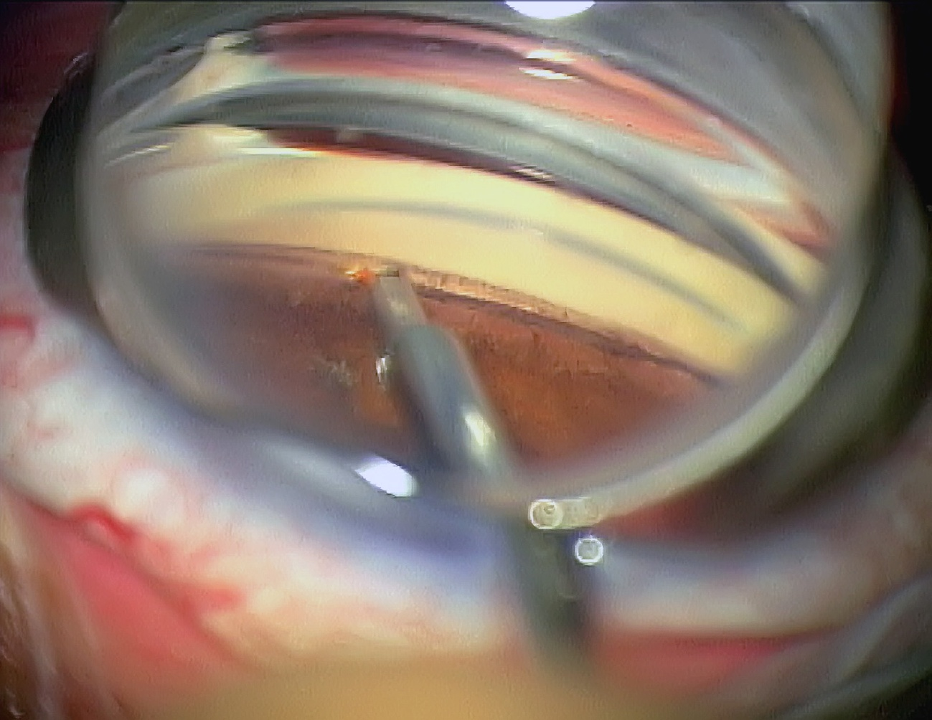
Trabectome: how?
Image courtesy of NeoMedix
Notes:
A clear gonioscopic view of the angle is required throughout the procedure.
Reference
Liu J, Jung J, Francis BA. Ab interno trabeculotomy: Trabectome™ surgical treatment for open-angle glaucoma. Expert Rev Ophthalmol 2009; 4: 119–128. [p120]

Slide 18
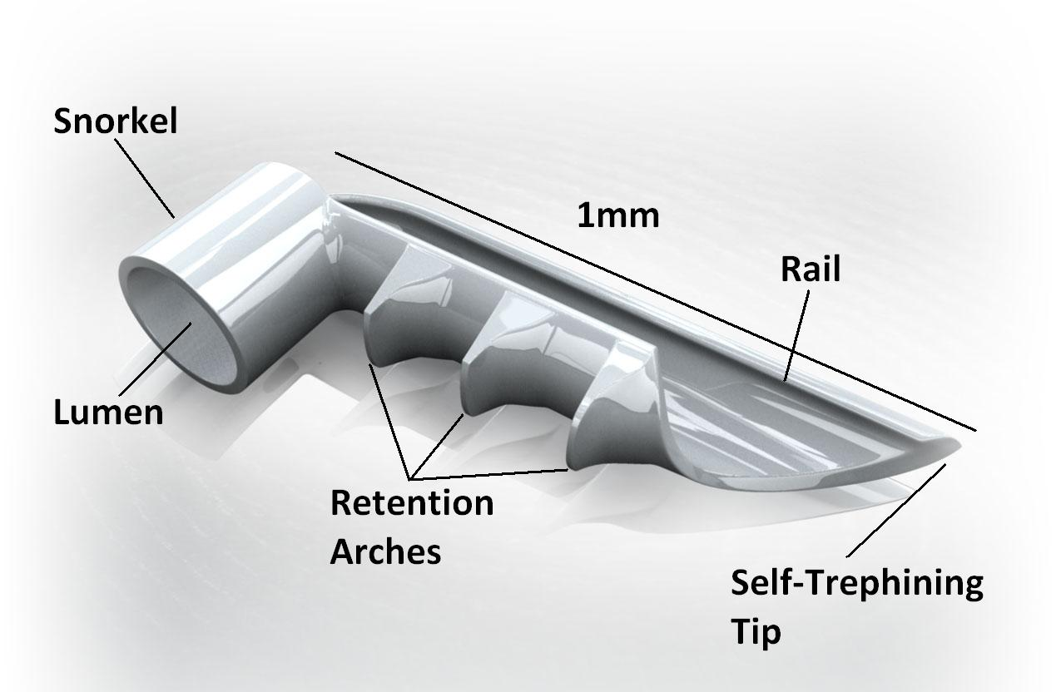
iStent: what?
Image courtesy of Glaukos.
Notes:
The iStent is implanted with one end in Schlemm’s canal and the other in the anterior chamber in order to shunt aqueous directly into Schlemm’s canal.¹ The device is made of heparin-coated, non-ferromagnetic titanium and measures 1 mm in length, with a lumen diameter of 120 μm.² A ‘snorkel’ (inlet) end is connected at right angles to the implanted portion, which has a pointed tip to aid tissue penetration.¹ The distal end opens into a half cylinder to help prevent blockages.¹ The convex side (with retention arches) is placed against the inner wall of Schlemm’s canal, with the open half-pipe against the outer wall.²
Theoretical advantages of the iStent are similar to those of the Trabectome procedure, plus the ability of the stent to maintain the patency of the pathway from the anterior chamber to Schlemm’s canal.¹ Potential disadvantages are that the opening is limited to the size of the stent and that access to collector channels is restricted to the area adjacent to the stent; in addition, the long-term effects of permanently implanting a device into the angle are unknown.¹
The iStent received FDA approval in June 2012 for use in combination with cataract surgery in mild-to-moderate OAG, and is also available in Europe and Canada.^{3,4} The FDA approval was based on a pivotal trial in which 70% of eyes treated with iStent plus cataract surgery had an unmedicated IOP ≤21 mmHg at 1 year, compared with 50% of eyes treated with cataract surgery alone (p < 0.001).⁵
Conical-shaped and suprachoroidal versions of the iStent have also been developed.⁶ Preliminary results have been reported for a study that compared cataract surgery alone or with implantation of two second-generation conical stents (reviewed in ref 6). At 1 year, unmedicated IOP of ≤18 mmHg was obtained in 77% of the iStent group vs. 24% of control eyes (p = 0.004).⁶ Although evidence suggests that implanting multiple stents is beneficial,⁶ the optimum number of stents has not been determined.
References
1. Francis BA, Singh K, Lin SC et al. Novel glaucoma procedures: a report by the American Academy of Ophthalmology. Ophthalmology 2011; 118: 1466–80. [p1470[
2. Traverso CE, Papadia M, Scotto R, Bagnis A. iStent®: trabecular micro-bypass stent for open-angle glaucoma. Expert Rev Ophthalmol 2010; 5: 443–450. [p445-6]
3. Food and Drug Administration, 25 June 2012. FDA approves first glaucoma stent for use with cataract surgery. Media release available at: www.fda.gov/NewsEvents/Newsroom/PressAnnouncements/ucm309667.htm. Accessed: 11 July 2012.
4. For further information, see www.glaukos.com/physicians/international.
5. Samuelson TW, Katz LJ, Wells JM, Duh YJ, Giamporcaro JE; US iStent Study Group. Randomized evaluation of the trabecular micro-bypass stent with phacoemulsification in patients with glaucoma and cataract. Ophthalmology 2011; 118: 459–67.
6. Saheb H, Ahmed IK. Micro-invasive glaucoma surgery: current perspectives and future directions. Curr Opin Ophthalmol 2012; 23: 96–104. [p98]

Slide 19
iStent: how?
Clear corneal incision*
Visco-elastic injection
Goniolens placement
Insertion of the implant
Irrigate and aspirate
* The iStent is inserted following cataract surgery, through the phaco incision
For details of the surgical procedure, see: www.glaukos.com/istent/surgical-procedure
Notes:
For details of the recommended iStent surgical procedure, see: www.glaukos.com/istent/surgical-procedure.
The iStent is implanted ab interno into Schlemm’s canal using a preloaded inserter; note that right-eye and left-eye models are available.¹ Gonioscopy should be performed prior to surgery to exclude PAS, rubeosis, and other angle abnormalities that would prevent adequate visualization of the angle and lead to improper stent placement.²
References
1. Traverso CE, Papadia M, Scotto R, Bagnis A. iStent®: trabecular micro-bypass stent for open-angle glaucoma. Expert Rev Ophthalmol 2010; 5: 443–450. [p445-6]
2. For further information, see www.glaukos.com/istent.

Slide 20
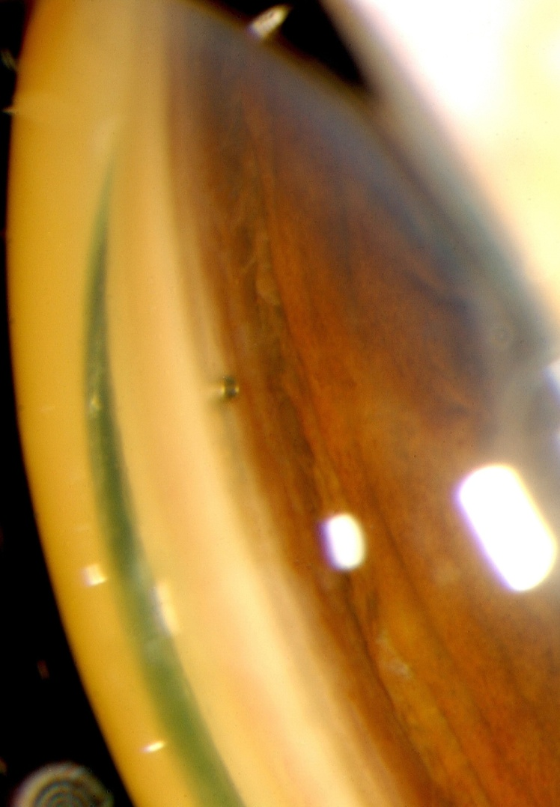
iStent: how?
Gonioscopic view of the implanted iStent device
Photo courtesy of Tom Samuelson, MD

Slide 21
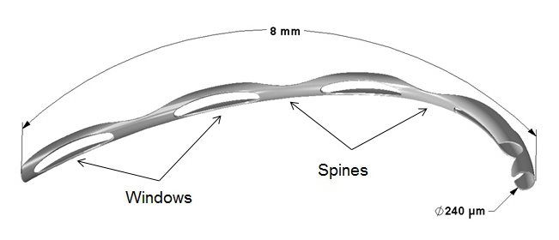
Hydrus micro-stent: what?
Available in Europe; US trials ongoing
Implantation is similar to iStent
Image courtesy of Ivantis ((TBC))
Notes:
The Hydrus™ micro-stent [Ivantis, Inc., Irvine, CA, USA] is made of a biocompatible nickel and titanium alloy (nitinol), and is designed for ab interno insertion into Schlemm's canal in conjunction with cataract surgery.¹ The crescent-shaped device measures 8 mm in length and is open posteriorly.²
Preliminary results for the Hydrus micro-stent combined with cataract surgery in patients with mild-to-moderate OAG showed a reduction in mean IOP from 22.1 (screening IOP; 28.6 pre-op washout) to 15.5 mmHg at 6 months, with 70% of patients medication-free at this time (vs. 7% at baseline).³
The IOP-lowering efficacy of the Hydrus device alone was also evaluated in mild-to-moderate OAG. Preliminary results showed that mean IOP decreased from 21.6 at screening to 16.9 mmHg at 6 months, with the mean number of medications decreasing from 1.7 to 0.6. Intra-operative complications among 40 patients included three cases of mild hyphaema and two cases of iris damage.⁴
A randomized, double-blind trial in the US (ClinicalTrials.gov Identifier: NCT01539239) is comparing cataract surgery followed by Hydrus micro-stent implantation with cataract surgery alone in OAG.⁵
The effect on outflow facility was compared for the Hydrus implant versus two iStent implants in perfused human anterior segments.⁶ A preliminary report found that outflow facility was increased by 72–90% with the 8-mm Hydrus implant vs. 36% with two iStent implants (p = 0.04); both implants significantly increased outflow vs. baseline and a sham procedure (control).⁶ A 15-mm Hydrus implant increased outflow by 92%.⁶
References
1. Information available at: www.ivantisinc.com.
2. Saheb H, Ahmed IK. Micro-invasive glaucoma surgery: current perspectives and future directions. Curr Opin Ophthalmol 2012; 23: 96–104.
3. Ahmed IK. Intracanalicular scaffold for IOP reduction with cataract surgery in mild to moderate open angle glaucoma. Presented at the American Society of Cataract and Refractive Surgery (ASCRS) Symposium and Congress. April 20–24, 2012, Chicago, IL, USA.
4. Lorenz K, Pfeiffer N, Ramirez M et al. 6 month results from a prospective, multicenter study of a nickel-titanium Schlemm’s canal scaffold for IOP reduction in open angle glaucoma. Poster presented at the 22nd Annual Meeting of the American Glaucoma Society (AGS). March 1–4, 2012, New York, NY, USA.
6. Toris CB, Gulati V, Fan S, Camras LJ, Ahmed I, Samuelson TW. Quantitative differences among novel glaucoma devices in a human perfusion model. Presented at the Association for Research in Vision and Ophthalmology (ARVO) Annual Meeting. May 6–10, 2012, Fort Lauderdale, FL, USA.

Slide 22
Uveal–scleral drainage: what and why?
Creates an alternative drainage pathway to the suprachoroidal space
No bleb is required
However, it is a difficult surgical technique
Notes:
The uveoscleral outflow pathway, which reportedly accounts for 20–54% of total aqueous outflow in normal human eyes, comprises the interstitium of the ciliary body, the suprachoroidal space and finally the choroidal and scleral vasculature.¹
Previous surgical approaches to increasing suprachoroidal outflow have included cyclodialysis and suprachoroidal implants, but these procedures had significant limitations.¹ More recently, a minimally invasive gold micro-shunt has been developed to create a conduit between the anterior chamber and the suprachoroidal space.¹ This results in a one-way flow of aqueous from the anterior chamber to the suprachoroidal space due to the presumed pressure differential of 1–5 mmHg between the two spaces.²
Similar to TM bypass procedures, increasing uveoscleral outflow does not require a bleb but is unlikely to lower IOP to the same extent as trabeculectomy.²
References
1. Tam DY, Ahmed IK. Incisional therapies: canaloplasty and new implant devices. In: Schacknow PN, Samples JR (eds.) The Glaucoma Book: A Practical, Evidence-Based Approach to Patient Care. New York: Springer; 2010. p. 795–812. [p795,796,798]
2. Francis BA, Singh K, Lin SC et al. Novel glaucoma procedures: a report by the American Academy of Ophthalmology. Ophthalmology 2011; 118: 1466–80. [p1467, 1468]

Slide 23
Uveal–scleral drainage: when?
Failed filtering surgery
No adequate conjunctival tissues
Notes:
The gold micro-shunt device discussed in the following slides is intended to enhance uveoscleral drainage and has been evaluated in patients with refractory glaucoma after the failure of prior filtering surgery.¹ Implantation does not involve the conjunctiva (although conjunctival dissection is required).¹
Reference
1. Figus M, Lazzeri S, Fogagnolo P, Iester M, Martinelli P, Nardi M. Supraciliary shunt in refractory glaucoma. Br J Ophthalmol 2011; 95: 1537–41.

Slide 24
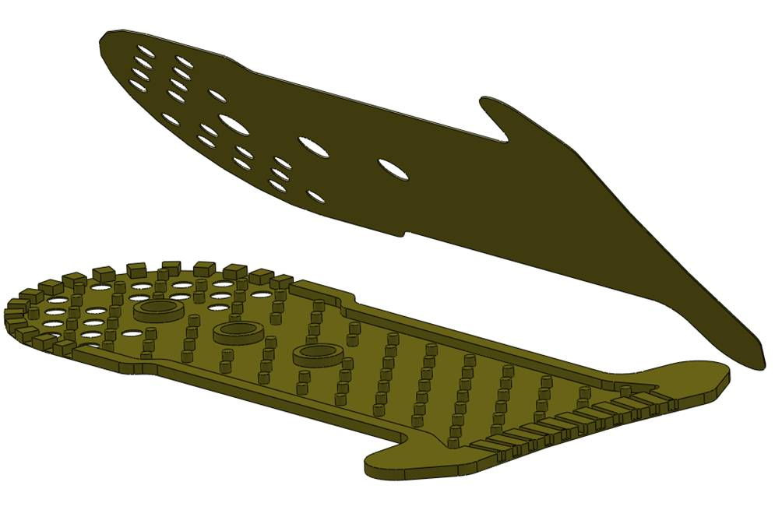
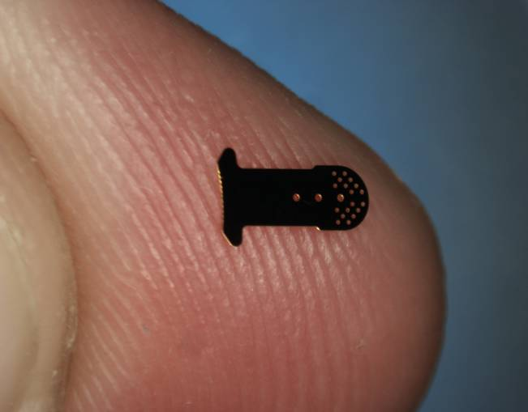
Gold micro-shunt: what?
Gold device drains aqueous humor from the anterior chamber to uveal tissue
Images courtesy of SOLX, Inc.
Notes:
The gold micro-shunt (GMS) [SOLX Inc., Waltham, MA, USA] is a 24-carat gold device designed to drain aqueous through and around the shunt from the anterior chamber (AC) to the suprachoroidal space, thus augmenting uveoscleral flow.¹ As of July 2012, it is approved for use in Canada and Europe.²
Gold is inert and has demonstrated long-term biocompatibility in the eye.¹ Consisting of two fused halves with channels connecting the anterior and posterior openings, the device length is 5.2 mm, with a width of 2.4 mm and 3.2 mm at the anterior and posterior ends, respectively, and a channel width of 25 μm.¹ The proximal end projects into the AC, while the distal end has two rounded projections to anchor the device in the suprachoroidal space.³ Numerous holes at each end allow flow into and out of the device.³
Theoretical advantages include the use of a novel outflow pathway without an external filtering bleb, and a low risk of hypotony.³ Disadvantages may include the risk of erosion or exposure associated with a permanent implant in the AC and suprachoroidal space, and incomplete understanding of the mechanism of action.³
In a pilot study, the mean IOP decrease was 9 mmHg (32%).⁴ In patients with refractory glaucoma and prior surgery, the mean IOP reduction was 13.9 mmHg (50%) at 2 years and the mean number of glaucoma medications decreased from 2.8 to 1.5.⁵ Hyphaema was the most common adverse event.^{4,5} Failure occurred in 33% of eyes, most commonly due to anterior blockage of the lumen by a thin membrane.⁵ Histological findings of five failed shunts showed a fibrotic capsule surrounding both ends of the device and connective tissue in the inner channels.⁶
Data collection for a randomised phase III trial comparing the SOLX gold shunt with the Ahmed valve in patients with refractory OAG was expected to be complete in July 2012.⁷
References
1. Tam DY, Ahmed IK. Incisional therapies: canaloplasty and new implant devices. In: Schacknow PN, Samples JR (eds.) The Glaucoma Book: A Practical, Evidence-Based Approach to Patient Care. New York: Springer; 2010. p. 795–812.
2. SOLX, Inc. For up-to-date information, see www.solx.com.
3. Francis BA, Singh K, Lin SC et al. Novel glaucoma procedures: a report by the American Academy of Ophthalmology. Ophthalmology 2011; 118: 1466–80. [p1468]
4. Melamed S, Ben Simon GJ, Goldenfeld M, Simon G. Efficacy and safety of gold micro shunt implantation to the supraciliary space in patients with glaucoma: a pilot study. Arch Ophthalmol 2009; 127: 264–9.
5. Figus M, Lazzeri S, Fogagnolo P, Iester M, Martinelli P, Nardi M. Supraciliary shunt in refractory glaucoma. Br J Ophthalmol 2011; 95: 1537–41.
6. Agnifili L, Costagliola C, Figus M et al. Histological findings of failed gold micro shunts in primary open-angle glaucoma. Graefes Arch Clin Exp Ophthalmol 2012; 250: 143–9.
7. SOLX Gold Shunt Versus Control Implant: Randomized Trial for Refractory Glaucoma. ClinicalTrials.gov Identifier: NCT00382395. Trial record available at: www.clinicaltrials.gov.

Slide 25
Gold micro-shunt: how?
Conjunctival flap
Scleral incision
Scleral tunnel
Suprachoroidal exposure
Insertion of shunt
Positioning of shunt
Closure
Notes:
Preoperative gonioscopy is essential as the angle anatomy should be relatively preserved at the implantation site.¹ Superior or inferior temporal locations are commonly used.¹
A fornix-based conjunctival flap is created, followed by a full-thickness scleral incision to expose the supraciliary space (3.5–4 mm, 2 mm posterior to the limbus).^{1,2} A paracentesis incision may be required.¹ Viscoelastic is injected or an anterior chamber maintainer positioned.^{1,2} Using a crescent blade, a scleral tunnel at 90–95% scleral thickness is created towards the anterior chamber at the level of the scleral spur.^{1,2} Intraoperative gonioscopy is valuable to determine the entry point into the anterior chamber.¹ The dissection is continued posteriorly into the suprachoroidal space (2–3 mm). The gold micro-shunt is gently inserted into the scleral tunnel and guided into place using a 27-gauge needle or the positioning holes on the device.¹ The posterior end is tucked into the suprachoroidal space and the head of the device is positioned so that 1–1.5 mm of the device remains in the anterior chamber and the anterior drainage openings are visible.^{1,2} The scleral incision is then closed in a water-tight fashion using 10–0 nylon sutures and lastly the conjunctival flap is closed.¹
References
1. Tam DY, Ahmed IK. Incisional therapies: canaloplasty and new implant devices. In: Schacknow PN, Samples JR (eds.) The Glaucoma Book: A Practical, Evidence-Based Approach to Patient Care. New York: Springer; 2010. p. 795–812. [p807-9]
2. Francis BA, Singh K, Lin SC et al. Novel glaucoma procedures: a report by the American Academy of Ophthalmology. Ophthalmology 2011; 118: 1466–80. [p1468]

Slide 26
CyPass micro-stent: what?
Transcend CyPass®
Investigational device
Polyimide micro-stent
Ab interno insertion into supraciliary space
Drainage into suprachoroidal space
Clinical trials ongoing in US and Europe
Notes:
The CyPass micro-stent [Transcend Medical, Menlo Park, CA, USA] is an investigational device undergoing clinical trials in the US and Europe.^{1,2} Made of polyimide (a biocompatible polymer) and measuring approximately 6 mm in length, it is inserted ab interno into the supraciliary space, creating a drainage conduit to the suprachoroidal space to enhance uveoscleral outflow.^{1,2} The lumen diameter is 300 μm.¹
The CyPass device has been evaluated as a stand-alone procedure, but much of the clinical trial experience involves patients undergoing concurrent cataract surgery.¹ In this procedure, the cataract surgery is completed first then the CyPass microstent is inserted through the phaco incision and positioned using a small guidewire (used to separate the iris from the scleral spur).¹ Preliminary data from a European trial (CyCLE) showed a 35% reduction in IOP at month 6 for patients whose baseline IOP was above 21 mmHg, with a corresponding decrease in medication use from 2.2 at baseline to 0.8 at 6 months.¹
The US study (COMPASS; ClinicalTrials.gov Identifier: NCT01085357) is a randomized, double-blind trial comparing cataract surgery alone or with CyPass implantation, and has a target accrual of over 700 patients with primary OAG.³
References
1. Flowers B, Herndon LW, Mosaed S, Simon G, Craven ER. The next generation of glaucoma surgeries. Glaucoma Today, August 2011. p.43–52. Available at: http://bmctoday.net/glaucomatoday/2011/08/article.asp?f=the-next-generation-of-glaucoma-surgeries. Accessed: 22 July 2012.
2. For further information, see www.transcendmedical.com and www.compassclinicalstudy.com/pages/for_referring_physicians.htm.
3. For further information, see www.clinicaltrials.gov/ct2/show/NCT01085357.

Slide 27
Ciliary destruction

Slide 28
Ciliary destruction: what?
Conventional trans-scleral ciliary destruction induces severe side effects
Endoscopic ciliary photocoagulation (ECP) may prove to be effective and relatively safe
Notes:
Endoscopic cyclophotocoagulation (ECP) incorporates a diode laser, video camera, aiming beam and light source transmitted via fibre optic cable to an 18-gauge or 20-gauge probe that is introduced into the eye, enabling direct visualization and treatment of the ciliary processes.¹ IOP reductions of 34–57% have been reported.²
ECP appears to be relatively safe compared to transscleral cyclophotocoagulation; nevertheless, there is the potential for serious complications.³
References
1. Lin SC. Endoscopic and transscleral cyclophotocoagulation for the treatment of refractory glaucoma. J Glaucoma 2008; 17: 238–47. [p239-240]
2. American Academy of Ophthalmology Glaucoma Panel. Preferred Practice Pattern® Guidelines. Primary Open-Angle Glaucoma: San Francisco: American Academy of Ophthalmology; 2010. Available at: www.aao.org/ppp. Accessed: 1 April 2012. [p24]
3. Lin SC. Procedural treatments: endoscopic cyclophotocoagulation. In: Giaconi JA, Law SK, Caprioli J (eds.) Pearls of Glaucoma Management. Berlin: Springer-Verlag; 2010. p. 257–262. [p258]

Slide 29
Endoscopic ciliary photocoagulation: why?
Partial destruction of the ciliary body which produces the aqueous humor
Reduced trauma to the adjacent normal tissues
Notes:
Transscleral cyclophotocoagulation often over-treats the ciliary tissues and causes significant damage to surrounding structures, including the pars plana, iris root and vasculature; this damage may be a factor in the significant rates of hypotony and phthisis observed with the transscleral approach.¹ Histological studies comparing ECP and transscleral cyclophotocoagulation have shown reduced tissue disruption with ECP.¹
Adverse events reported after ECP in eyes with advanced glaucoma include fibrin exudates, hyphaema, cystoid macular oedema, vision loss, hypotony, choroidal detachment and phthisis.¹ However, fewer such complications have been observed in eyes with less advanced glaucoma.¹
A study that compared ECP with the Ahmed drainage implant in refractory glaucoma found that success rates were similar, but there were fewer complications with ECP.³
References
1. Lin SC. Endoscopic and transscleral cyclophotocoagulation for the treatment of refractory glaucoma. J Glaucoma 2008; 17: 238–47. [p244-5]
2. American Academy of Ophthalmology Glaucoma Panel. Preferred Practice Pattern® Guidelines. Primary Open-Angle Glaucoma: San Francisco: American Academy of Ophthalmology; 2010. Available at: www.aao.org/ppp. Accessed: 1 April 2012. [p24]
3. Lima FE, Magacho L, Carvalho DM, Susanna R Jr, Avila MP. A prospective, comparative study between endoscopic cyclophotocoagulation and the Ahmed drainage implant in refractory glaucoma. J Glaucoma 2004; 13: 233–7.

Slide 30
Endoscopic ciliary photocoagulation: when?
Combined with lens extraction
Failed filtering surgery
No adequate conjunctival tissues
Notes:
Cyclodestructive procedures have traditionally been used after the failure of filtering surgery and in eyes with little or no visual potential.¹ Difficult-to-treat glaucoma types that may be candidates for cyclodestructive procedures include eyes with scarred conjunctival tissues (from disease or prior surgery), neovascular glaucoma, glaucoma associated with aphakia, trauma or penetrating keratoplasty, and severe congenital glaucoma.¹
ECP is also suitable for eyes with relatively intact central visual acuity.² More recently, ECP has been used as a primary procedure, especially in combination with cataract surgery.¹ However, concerns have been expressed regarding the increasing use of ECP for primary surgery due to the significant learning curve for the procedure, the potential for serious adverse events, and the lack of long-term efficacy data.²
The IOP-lowering efficacy of ECP is typically modest, thus filtration surgery remains the preferred choice for eyes with very high IOP, as well as in advanced glaucoma where a very low IOP is required.² In eyes with very poor vision, unnecessary exposure to the risks of penetrating intraocular surgery should be avoided and ECP may not be appropriate.¹
A phakic eye is a relative contraindication to ECP, because the probe size makes the procedure difficult and there is a significant risk of lens damage.²
References
1. Lin SC. Endoscopic and transscleral cyclophotocoagulation for the treatment of refractory glaucoma. J Glaucoma 2008; 17: 238–47. [p238,245]
2. Lin SC. Procedural treatments: endoscopic cyclophotocoagulation. In: Giaconi JA, Law SK, Caprioli J (eds.) Pearls of Glaucoma Management. Berlin: Springer-Verlag; 2010. p. 257–262. [p257,258]

Slide 31
Endoscopic ciliary photocoagulation: how?
Insert the probe through the pars plana or clear corneal wound
Perform ciliary ablation over at least 180 degrees
Maintain the IOP throughout the procedure
Notes:
A limbal (clear cornea) or pars plana approach may be used.¹ A limbal approach is usually recommended for anterior segment surgeons as it avoids anterior vitrectomy (with the associated risk of choroidal and retinal detachment), but the pars plana approach is safer in some cases (e.g. aphakic eyes with posterior synechiae where access to the ciliary sulcus is difficult).¹ The pars plana approach should not be used in phakic eyes, and anterior segment surgeons without considerable experience in posterior segment surgery are advised to involve a retinal surgeon for the establishment of the pars plana entry port and the limited anterior vitrectomy.¹
Ciliary ablation is performed over a minimum of 180° of the ciliary body;¹ treating 270°–360° is desirable and may be required for a satisfactory response.^{1,2} Using a curved probe increases the area that can be treated through a single incision.¹ With the limbal approach, the nasal 180° are treated then a second incision is created at the nasal limbus to facilitate treatment of the temporal processes.¹
Viscoelastic is used to fill the anterior chamber during the procedure.¹ In addition, it may be used to expand the posterior chamber in order to facilitate access to the ciliary processes, as well as to avoid hitting or burning the iris with the probe.¹
References
1. Lin SC. Procedural treatments: endoscopic cyclophotocoagulation. In: Giaconi JA, Law SK, Caprioli J (eds.) Pearls of Glaucoma Management. Berlin: Springer-Verlag; 2010. p. 257–262. [p259,260]
2. American Academy of Ophthalmology Glaucoma Panel. Preferred Practice Pattern® Guidelines. Primary Open-Angle Glaucoma: San Francisco: American Academy of Ophthalmology; 2010. Available at: www.aao.org/ppp. Accessed: 1 April 2012. [p24]

Slide 32
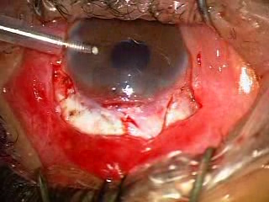
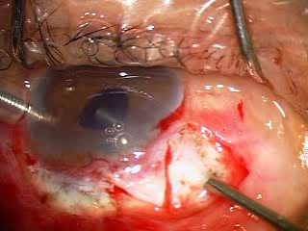
Endoscopic ciliary photocoagulation: how?
Insertion of anterior chamber maintainer
Laser probe insertion via pars plana region
Photos courtesy of Da-wen Lu

Slide 33
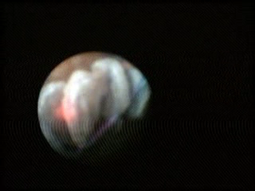
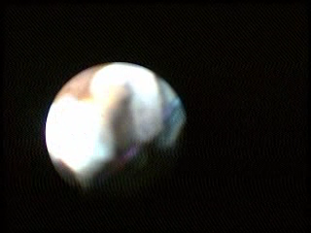
Endoscopic ciliary photocoagulation: how?
Viewing the ciliary process
Burning by laser
Photos courtesy of Da-wen Lu
Notes:
The laser is set on continuous wave and the ciliary processes are treated individually or across multiple processes in a ‘painting’ technique. Energy is applied until the treated processes appear white and shrunken (right photo). If explosion or ‘popping’ of ciliary processes is seen, the probe should be moved further away or the laser energy decreased.
Reference
Lin SC. Procedural treatments: endoscopic cyclophotocoagulation. In: Giaconi JA, Law SK, Caprioli J (eds.) Pearls of Glaucoma Management. Berlin: Springer-Verlag; 2010. p. 257–262. [p259-260]

