Slide 1
GLAUCOMA ASSESSMENT
Notes:
This presentation aims to provide the practising ophthalmologist with an updated understanding of the assessment of patients with glaucoma or those suspected of having glaucoma. Following the concepts outlined here can translate into improved detection and evaluation of glaucoma and, ultimately, more effective prevention of visual loss and blindness.

Slide 2
Glaucoma assessment
Initial assessment
History
Examination/investigations
Key points
Notes:
This module introduces the aims and key components of initial glaucoma assessment, followed by separate sections dedicated to history and examination/investigations. The final slide lists key take-home messages from the presentation.
At the end of the presentation, participating clinicians should be able to:
obtain a patient’s history in a logical, organised and thorough manner
identify points in the history that may be relevant to the diagnosis and treatment of glaucoma
consider other factors that may impact on glaucoma management
describe the clinical work-up in the diagnosis of glaucoma
understand the concepts behind the different tests and procedures used to diagnose and evaluate glaucoma.

Slide 3
Initial assessment
Ask yourself:
Is glaucoma present or not?
Will glaucoma develop in the future?
Assess risk factors
Alternative diagnoses?
What is the mechanism of damage?
What is the plan for management?
Which treatment is most suitable?
Notes:
The initial consultation lays the foundation for successful management of glaucoma. Early, thorough evaluation of patients suspected of having glaucoma is essential, as the progression of glaucomatous optic neuropathy and permanent blindness can be prevented by appropriate treatment.
The aims during initial assessment are:
to determine whether or not glaucoma is present, or likely to develop or progress (i.e. assess risk factors)
to exclude or confirm alternative diagnoses
to identify the underlying mechanism(s) of damage in order to guide the choice of management
to begin planning a management strategy
to identify suitable forms of treatment, and to exclude those that are inappropriate.

Slide 4
Phases of initial assessment
History
Chief visual complaint
Ophthalmic history
Medical history
Socioeconomic factors
Family history
Notes:
The initial assessment of a patient suspected of having glaucoma can be divided into history-taking and examination/investigations.
The points listed in this slide are intended to help clinicians develop a thorough, efficient and systematic approach to evaluating patients. The information obtained from a patient’s ophthalmic, medical, social and family history, combined with data from appropriate, properly executed and accurate examination of the eye will prove useful in diagnosing glaucoma and formulating a treatment strategy.

Slide 5
Phases of initial assessment (cont.)
Examination/investigations
Appropriate equipment
Sufficient training in examination techniques
Accurate and reliable recording of findings
Notes:
The initial assessment of a patient suspected of having glaucoma can be divided into history-taking and examination/investigations.
The information obtained from a patient’s ophthalmic, medical, social and family history, combined with data from appropriate, properly executed and accurate examinations of the eye will prove useful in diagnosing glaucoma and formulating a treatment strategy.

Slide 6
History: key points
A full medical history is essential
In most cases, glaucoma is asymptomatic until advanced
Evaluate risk factors
Including family history
Assess medical and social factors that will affect treatment decisions
Consider the patient’s age
Notes:
A full medical history is essential, as a range of systemic diseases and treatments can affect intraocular pressure and glaucoma. It is important to establish whether there is a family history of glaucoma – a positive family history is associated with a 5-fold increase in the risk of glaucoma, with first-degree relatives at the highest risk. Note that younger patients will have a longer exposure to glaucoma and its treatment.

Slide 7
Glaucoma risk factors
Key risk factors for developing open-angle glaucoma
Higher IOP
Increasing age
Ethnicity
Family history (especially first-degree relatives)
Myopia
The presence of multiple risk factors increases the glaucoma risk
Notes:
Additional risk factors for developing open-angle glaucoma include diabetes. thinner central corneal thickness, the presence of contralateral disease, optic disc haemorrhage, larger cup-to-disc ratio, higher visual field sensitivity deviation, vasospasm, and possibly sleep apnoea.
The presence of multiple risk factors increases the glaucoma risk.
IOP: intraocular pressure.

Slide 8
Ophthalmic history
Visual symptoms of acute IOP elevation or glaucoma
Intermittent/episodic blurring, discomfort and frontal headache
Coloured rings around lights/glare
Needs to be differentiated from migraine
Poor light/dark adaptation
Difficulty in tracking fast-moving objects
Notes:
Many patients do not experience symptoms until their vision is compromised and extensive damage to the optic nerve has occurred. Patients may complain of blurred vision, eye discomfort, headache, coloured rings around lights, or glare. Clinicians may ask patients about their ability to adapt to different levels of illumination (e.g., difficulty seeing in the dark or bumping into objects), or problems detecting and tracking fast-moving objects, for example while playing sport.
Note that visual blurring and discomfort may be caused by a variety of conditions, including acute IOP elevation in the presence of angle closure, Posner–Schlossman syndrome, pigment dispersion, or pseudoexfoliation. Migraine and cataracts may also be responsible for glare or the appearance of coloured rings around lights, while poor light-dark adaptation and difficulty in tracking fast-moving objects may be due to retinal nerve fibre damage.

Slide 9
Ophthalmic history (cont.)
Trauma, eye surgery or laser treatment
Angle recession, lens dislocation, choroidal or retinal damage, ocular surgery, LASIK, spectacle use
Medication history
Especially glaucoma medications, steroids
Allergies or adverse reactions
Notes:
LASIK: laser-assisted in situ keratomileusis

Slide 10
Medical history – diagnosis
Systemic conditions relevant to diagnosis
Cardiovascular system | Vasospastic tendency, previous episodes of profound hypotension or blood loss, ischaemic heart disease, CABG
Central nervous system | Previous cerebrovascular accident, head injury, pituitary lesions, migraine
Endocrine system | Diabetes, thyroid eye disease, pituitary tumours
Notes:
Certain factors in a patient’s medical history may be relevant to diagnosis. For example, the occurrence of a stroke or head injury, or the presence of pituitary lesions, may be related to visual field loss. Migraine may be considered as a differential diagnosis presenting with symptoms similar to those of glaucoma. In addition, vasospastic tendency (including migraine and Raynaud’s phenomenon) may be associated with an increased incidence and severity of glaucoma, especially normal-tension glaucoma. Diabetes, which is increasingly prevalent, has been associated with open-angle and neovascular glaucoma.
CABG: coronary artery bypass graft

Slide 11
Medical history – treatment
Systemic conditions relevant to treatment
Cardiovascular system | Cardiac arrhythmias, systemic hypertension, ischaemic heart disease
Central nervous system | Early dementia, depression, tremor
Musculoskeletal system | Osteoarthritis, rheumatoid arthritis
Respiratory system | Asthma and other chronic obstructive pulmonary disease
Urogenital system | Urinary stones, renal disease
Women | Present or possible pregnancy and lactation
Notes:
Other factors in a patient’s medical history may be relevant when making treatment decisions. For instance, cardiac arrhythmias may preclude the use of topical beta-blockers or alpha-agonists. Over-treatment of systemic hypertension may worsen glaucoma risk and progression, while systemic beta-blockers may mask elevated IOP. The presence of asthma and chronic obstructive pulmonary disease associated with hyper-responsive airways and/or reduced lung capacity also limits the use of topical beta-blockers. Early dementia and depression can affect the patient’s adherence to treatment and their insight into the disease. The presence of urinary stones may limit the use of systemic carbonic anhydrase inhibitors. Arthritis may severely affect the ability to administer eye drops. Finally, all interventions need to be evaluated for potentially hazardous effects in women who are pregnant or breastfeeding.

Slide 12
Medical history – haemodynamic crises
Exclude past haemodynamic crises or intracranial pathology
postpartum haemorrhage
ruptured abdominal aneurysm
severe trauma
major surgery (e.g. CABG)
prior blood transfusions
Haemodynamic crises may cause optic disc pallor and cupping that mimics glaucoma, but is not progressive
Notes:
Patients who have suffered from past haemodynamic compromise may have experienced a sudden loss of blood supply to the optic nerve, leading to pallor and cupping of the optic nerve as well as visual field loss resembling that seen in chronic glaucoma. Although anterior ischaemic optic neuropathy may mimic glaucoma, it is not progressive.

Slide 13
Medical history
Medications that may lead to glaucoma or glaucoma-like changes
Steroids
Associated with ocular hypertension, open-angle glaucoma
Anticholinergics/tricyclic antidepressants
Can cause angle closure
Anticonvulsants
Topiramate – can cause acute angle closure
Vigabatrin – linked to nasal peripheral field loss without disc
changes
Notes:
Clinicians need to enquire about the use of all current medications to ensure there are no contraindications for glaucoma treatment, and to be aware of the potential for adverse effects. In addition, the past use of medications that may lead to glaucoma or glaucoma-like changes should be reviewed. This include steroids, which are associated with ocular hypertension and open-angle glaucoma. Note that some traditional medicines may contain steroids, and that steroids can increase IOP regardless of the route of administration. Anticholinergic drugs or tricyclic antidepressants can cause angle closure, as can the anticonvulsant topiramate, while vigabatrin use has been linked to nasal peripheral field loss without disc changes.
Drug classes that may induce angle closure include sulphur-based agents, agents producing pharmacological mydriasis (e.g., adrenergic agents, anticholinergic agents and histamine receptor antagonists), agents associated with haemorrhagic or serous choroidal effusion (including warfarin and candesartan), and cholinergic agents associated with ciliary block glaucoma.

Slide 14
Medical history (cont.)
Medications that may have an impact on glaucoma treatment
Long-term use of glaucoma drops
May increase trabeculectomy failure
Systemic beta-blockers or calcium channel blockers
May interact with topical beta-blockers
May mask raised IOP
Alpha-agonists are contraindicated for:
Patients taking MAOIs
Infants and children
Check for sulpha allergy before using CAIs
Notes:
Prolonged use of ophthalmic solutions to lower IOP may increase the failure rate of trabeculectomy. Systemic beta-blockers or calcium channel blockers may interact with topical beta-blockers or mask raised IOP. Alpha-agonists are contraindicated in all patients taking MAOIs (which may be prescribed for depression, migraine prophylaxis or Parkinson’s disease), and in infants and children. Clinicians should check for sulpha allergy prior to prescribing CAIs.
CAI: carbonic anhydrase inhibitor
MAOI: monoamine oxidase inhibitor

Slide 15
Further considerations
Impact of glaucoma on the patient
How regularly can the patient attend the clinic?
Can the patient afford and comply with treatment?
How will having glaucoma affect the patient’s life, work and family?
Consider disease and treatment effects
Notes:
Practical considerations also need to be addressed when tailoring a management strategy for a patient with glaucoma. Answering the questions listed in this slide will help the clinician assess the impact of the condition on the patient, and guide decisions on the appropriate course of treatment.

Slide 16
Further considerations (cont.)
What is the patient’s life expectancy?
What is the patient’s lifestyle?
Exercise
Water intake
Alcohol use
Family history
What is the disease type and course in the patient’s family?
Notes:
As the goal of glaucoma therapy is to ensure that patients have minimal to no functional visual impairment due to glaucoma in their lifetime, the clinician must determine both how quickly their patients are approaching functional impairment and their probable life expectancy.
Lifestyle considerations include the patient’s choice of exercise (head-down or inverted yoga positions can potentially increase intraocular pressure [IOP], while dehydration and/or acidosis associated with physical exertion can reduce it), pattern of water intake (rapid consumption of a large volume of water may elevate IOP) and alcohol use (alcohol tends to reduce IOP levels).

Slide 17
Examination and investigations
Desirable resources for examination
A slit lamp with indirect lens between 60–90D and/or direct ophthalmoscope
Automated perimeter
A gonioscope that allows indentation gonioscopy
A Goldmann applanation tonometer (GAT) or Tono-Pen®
Notes:
Glaucoma examination requires appropriate equipment, sufficient training in examination techniques, and accurate and reliable recording of findings. While resources vary widely across the Asia-Pacific region, this list of desirable resources required for examination has been agreed on.
Schiötz and Maklakov tonometers are not generally acceptable.

Slide 18
When the patient cannot get to a slit lamp
A hand-held slit lamp may be very useful
Anterior segment evaluation can also be accomplished using:
A jeweller’s loop or an operating loop with a torchlight
A direct ophthalmoscope set at +10 to +12D
In this setting, IOP is best measured using a Tono-Pen® or Perkins tonometer

Slide 19
Full eye examination
Every eye deserves a comprehensive examination, including:
Slit lamp examination
Applanation tonometry
Gonioscopy
Stereoscopic, dilated optic nerve examination*
* If the angle permits.
Notes:
A comprehensive eye examination may include slit lamp examination, applanation tonometry, gonioscopy and stereoscopic, dilated optic nerve examination if the angle width permits.

Slide 20
Goldman applanation tonometer (GAT)
Why? | IOP elevation is a major risk factor for glaucoma IOP lowering delays glaucoma progression
What to use? | GAT Tono-Pen® if GAT is not available
When? | Record the presenting or maximum IOP Every visit
Notes:
Elevated IOP remains the only modifiable risk factor for open-angle glaucoma, thus making tonometry an important aspect of glaucoma assessment and management. In tonometry, the eye is subjected to a force that flattens the cornea, which is then related to the IOP.
The standard instrument for measuring IOP is the GAT, which is attached to the slit lamp and measures the force needed to flatten an area of the cornea. Its use requires some training in interpreting the semicircular fluorescein rings seen through the biomicroscope. The Tono-Pen® (Reichert, Inc.), an electronic hand-held applanation tonometer with a tip covered by a disposable cover, can be used if there is no GAT available. This device allows the clinician to use a minimally invasive approach to obtain a rapid reliable reading. The Tono-Pen® must be calibrated appropriately before use.
The air puff non-contact tonometer also works on the applanation principle and shows reasonable agreement with GAT over the physiological IOP range. However, its variability is higher than GAT, which remains the gold standard.
GAT: Goldmann applanation tonometer

Slide 21
Tonometry
How? | Ensure tonometer is calibrated Disinfect prism tip and remove disinfectant Keep eyelashes out of the way If the upper lid needs to be retracted, do this without pressuring the globe Ensure the patient does not valsalva and continues to breathe during IOP measurement.
Notes:
This slide lists tips on performing Goldmann applanation tonometry. The tonometer tip should be cleaned with wipes soaked in 70% isopropyl alcohol or 3% hydrogen peroxide. Time should be allowed for alcohol to evaporate. Sterile saline solution should be used to wash off hydrogen peroxide before the next patient to prevent iatrogenic corneal ulcers.

Slide 22
Tonometry (cont.)
How? | Anaesthetise the cornea and instil fluorescein Gently touch the tip to the central cornea Look through the slit-lamp eyepiece just prior to the tip making contact Watch for the white split ring that fluoresces when the tip touches the cornea Adjust the gauge until the split tear meniscus just touches on the inside
Notes:
This slide lists tips on performing Goldmann applanation tonometry.

Slide 23
Factors affecting IOP measurement
Time of measurement
Circadian cycle
Timing of medication
Central corneal thickness
Corneal oedema
Laser refractive surgery
Blood pressure
Intra-abdominal pressure
Age
Exercise
Lifestyle
Wind instruments
Yoga
Goggle
Posture
Notes:
Many factors can affect the accuracy of an IOP reading.
Time of measurement – IOP follows a circadian cycle, often with a peak in the morning and a trough in the evening. The normal diurnal variation is 3–6 mmHg. IOP also varies with posture. The effect of medication use just prior to measurement is another important consideration.
Central corneal thickness – thicker corneas are associated with artificially elevated IOP measurements; thinner corneas with artificially low IOP measurements. Correction nomograms based solely on corneal thickness are not useful in individual patients.
Corneal oedema can cause a falsely low IOP reading. However, mild corneal oedema secondary to contact lens wear can cause a falsely high reading.
Laser refractive surgery causes a falsely low IOP measurement.
Blood pressure – IOP is positively associated with systemic blood pressure, particularly systolic pressure, but the relationship is not straightforward.
Intra-abdominal pressure – IOP is increased by intra-abdominal pressure associated with playing wind instruments or the Valsalva manoeuvre.
Age – increasing age is associated with increased IOP, although systemic hypertension may confound this relationship.
Exercise – exercise may increase (e.g. head-down positions during yoga) or reduce (by dehydration and/or acidosis) IOP by 2–6 mmHg.
Lifestyle – rapid intake of large volumes of fluid increases IOP; alcohol and marijuana have the opposite effect.
Posture – horizontal or head-down positions increase IOP.

Slide 24
Measurement errors with GAT
IOP reading artificially low | Insufficient fluorescein in tear film Microcystic epithelial corneal oedema
IOP reading artificially high | Excessive fluorescein in tear film Eyelid or digital pressure on globe Obese patient Patient holding breath, wearing constricting clothes, or straining to reach chin/forehead rest Hair lying across cornea distorting mires Lens–corneal apposition
Technical difficulties | Corneal abnormalities or marked corneal astigmatism Small palpebral aperture Nystagmus Tremor
Notes:
This slide shows some of the measurement errors potentially associated with GAT.

Slide 25
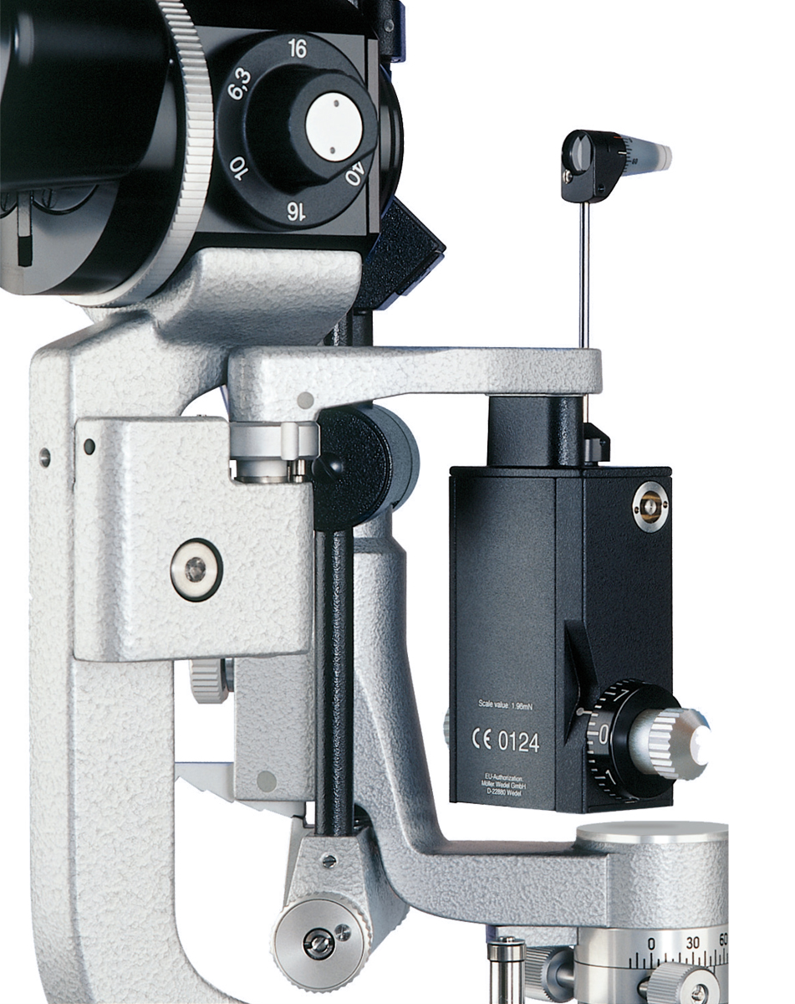
Tonometry – calibration
Testing the calibration of a GAT
Threshold tension levels
0 mmHg
20 mmHg
60 mmHg
Demonstration
Notes:
It is necessary to keep the GAT well maintained, and to ensure that regular servicing and calibration is carried out. This slide and the subsequent video presentation will help familiarise clinicians with the steps involved in testing the calibration of a GAT.
The three threshold tension levels used to test the tonometer’s calibration are 0, 20 and 60 mmHg. At each of these thresholds, the dial can be gently twirled backwards and forwards, and the tension read as the head responds. These points should bracket the threshold level evenly – the higher the level being tested, the greater the interval is likely to be.
A hands-on demonstration, if possible, may be carried out at this point; alternatively, a video showing how to test the calibration of a GAT may be played.

Slide 26
Examining the anterior segment
Globe surface
Episcleral blood vessels
Conjunctival injection (papillae or follicles)
Cornea and anterior chamber
Pigment dispersion
Anterior chamber depth
Peripheral – Van Herick test
Central
Inflammation
Descemet’s membrane rupture (Haab’s striae)
Corneal diameter and curvature
Notes:
This slide and the following slide highlight areas of interest when examining the anterior segment.
When examining the cornea and anterior chamber, be aware of pigment on the corneal endothelium (pigment dispersion). The peripheral anterior chamber depth can be estimated using the Van Herick test, which is covered in more detail on subsequent slides. Signs of inflammation include keratic precipitates and anterior chamber flare and cells.

Slide 27
Examining the anterior segment (cont.)
Iris
Mid-dilated poorly reactive (post-angle closure attack)
Patch atrophy or spiralling
Rubeosis iridis
Synechiae
Ectropion uvea
Configuration relative to lens
Displaced pupil with iris atrophy and/or holes
Pigmented iris nodule
Lens
PXF material
Lens opacity
Phacodonesis
Glaukomflecken
Early PXF changes after pupillary dilatation
Notes:
When examining the iris, pay attention to its configuration in relation to the lens, noting the presence of the following:
PXF material on the pupil edge
pigment deposits on the anterior surface (PXF or pigment dispersion)
transillumination defect (PXF – peripupillary; pigment dispersion – mid-peripheral)
loss of pupillary ruff (early sign of PXF).
A displaced pupil with iris atrophy and/or holes may be associated with ICE syndrome or Axenfeld–Rieger syndrome, while a pigmented iris nodule may occur with ICE syndrome of the Cogan-Reese type.
When examining the lens, the presence of glaucomflecken indicates past acute high IOP.
ICE: iridocorneal endothelial
PXF: pseudoexfoliation

Slide 28
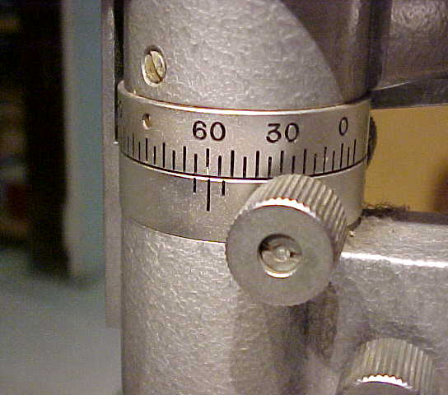
Van Herick test
Leuenberger EU
Asian Eye Institute
Foster P
Notes:
The anatomy of the iridocorneal angle should be assessed prior to the instillation of mydriatic agents to avoid precipitation of acute iatrogenic glaucoma. Although gonioscopy provides the most accurate measurement of this angle, a technique described by van Herick enables a quick assessment of the limbal anterior chamber depth using a slit lamp without additional aids.¹
The van Herick test uses a slit beam to compare the peripheral anterior chamber depth with the corneal thickness. The reported sensitivity and specificity of the van Herick test ranges from 62% to 91% for sensitivity and 53% to 96% for specificity.^{2,3} Although the specificity increases to 99% if the van Herick test is positive and IOP is increased, this strategy is not appropriate for screening or diagnosis; gonioscopy is required.⁴
References
1. Van Herick W, Shaffer RN, Schwartz A. Estimation of width of angle of anterior chamber. Incidence and significance of the narrow angle. Am J Ophthalmol 1969; 68: 626–9.
2. Thomas R, George T, Braganza A, Muliyil J. The flashlight test and van Herick's test are poor predictors for occludable angles. Aust N Z J Ophthalmol 1996; 24: 251–6.
3. Pearson R. Optometric grading scales for use in everyday practice. Optometry Today, 17 October 2003: 39–42. Available at: www.optometry.co.uk/articles/docs/e022e939c23ddd43951691b84a1efa90_pearson20031017.pdf.

Slide 29
Van Herick test (cont.)
Slit image on surface of cornea
Width of chamber angle less than half the width of the corneal slit image – possible angle closure
Chamber angle
Slit image on surface of the iris
Notes:
In the van Herick test, a narrow slit of light is projected onto the peripheral cornea at an angle of 60° as closely as possible to the limbus. This results in a slit image on the surface of the cornea, the width of which is used as reference for the assessment of the conditions in the chamber angle. The width of the chamber angle can be described by the distance between the corneal slit image and the slit image on the iris.
This slide has animation. Click the mouse while in slideshow to start.

Slide 30
Van Herick video
Video courtesy of Sankara Nethralaya eye hospital, Chennai, India (www.sankaranethralaya.org).
Video courtesy of Sankara Nethralaya eye hospital, Chennai, India (www.sankaranethralaya.org).

Slide 31
Simplified van Herick test
Is the result > 50% corneal thickness?
Yes
No
Angle closure less likely
Gonioscopy essential to determine angle closure risk
Notes:
If the optically empty region between the two slit images has at least the same width as the slit projected onto the cornea, the chamber angle is widely open and angle closure is very unlikely. Angle closure is possible if the distance between the posterior surface of the cornea and the iris is less than half the width of the corneal slit image. In this case, the anterior chamber angle of the affected eye should be measured with a gonioscope.

Slide 32
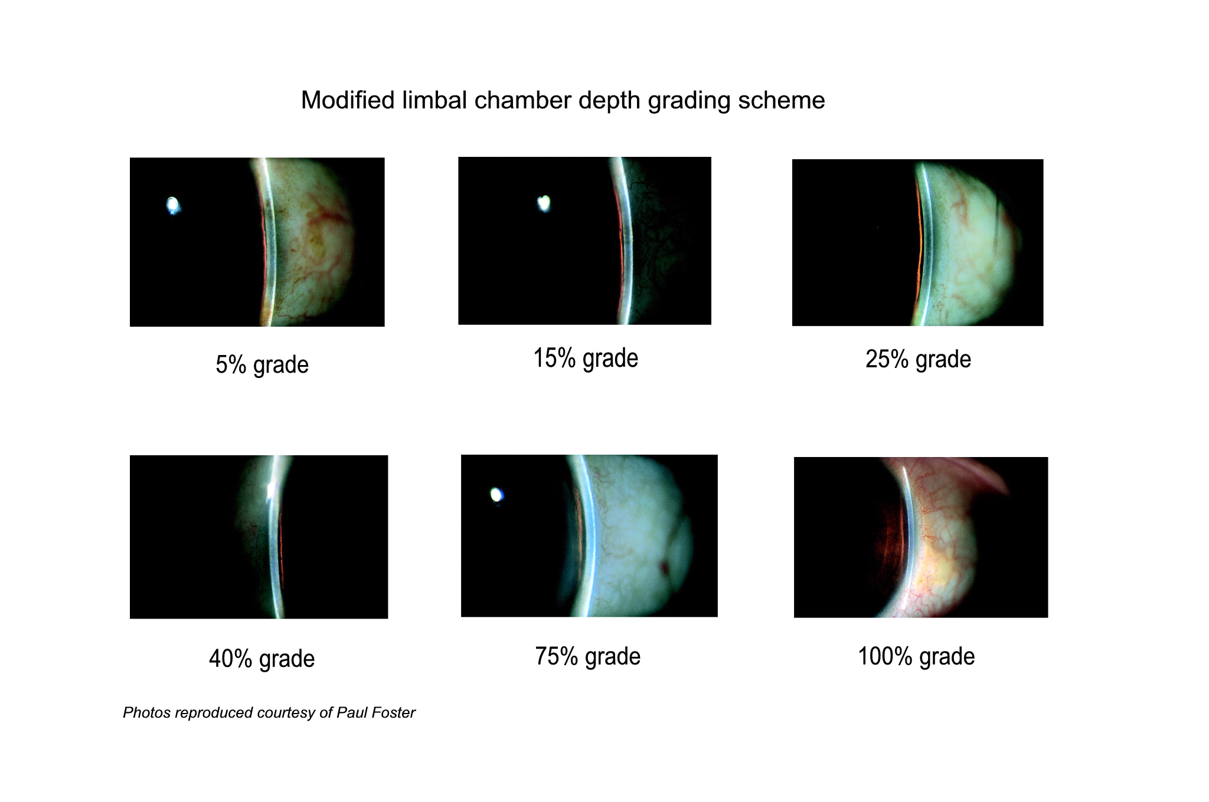
Van Herick grading
< 50% grade
< 50% grade
< 50% grade
< 50% grade
> 50% grade
> 50% grade
Foster P
Notes:
These examples of slit lamp views using the van Herick test are intended to illustrate the difference between a grade of < 50% (requiring gonioscopy) and one of > 50%.
Invite the audience to estimate the grade for each photo, then click the mouse to highlight slit lamp views showing a grade of < 50%, representing a high risk for angle closure.

Slide 33
Van Herick test and gonioscopy
Not a substitute for gonioscopy
Useful when gonioscopic view is hazy
e.g., corneal oedema, guttata, scarring
Only an estimate of angle depth
Pre-dilation evaluation when lens not available
Can miss clinically significant signs
e.g., angle recession, keratic precipitates, synechiae, abnormal pigments, ghost cells, tumours
Notes:
It must be stressed that the van Herick test only estimates the chamber angle and that the most accurate way to measure this angle is through gonioscopy. The van Herick test may be useful as a screening tool to rule out angle closure prior to pupillary dilatation and can serve as an effective teaching aid for gonioscopy.

Slide 34
Gonioscopy
Why? | Detect angle closure and secondary glaucomas
What? | Angle width and characteristics
When? | Initially for all patients Repeated more frequently for patients with angle closure
How? | See Module 2: Angle Assessment
Notes:
Gonioscopy is covered in detail in a subsequent module.

Slide 35
Optic nerve head and retinal nerve fibre layer
Why? | Defines glaucoma
What to look for? | Scleral ring (disc size and shape) Neuroretinal rim Disc haemorrhage Retinal nerve fibre layer (RNFL) defect Peripapillary atrophy Vascular pattern
When? | Every visit
How? | See Module 3: Optic Disc and RNFL Assessment
Notes:
Examination of the optic nerve head and retinal nerve fibre layer provides clues as to whether structural damage due to glaucoma has occurred. Characteristic features include a high cup–disc ratio, narrowing or notching of the neuroretinal rim, the presence of optic disc haemorrhages (a very specific finding for glaucoma that suggests an active disease process), retinal nerve fibre layer defects, peripapillary atrophy and changes in vascular pattern. This examination should be performed at every patient visit.

Slide 36
Optic nerve head and retinal nerve fibre layer (cont.)
Can you see disc?
No
Follow vessels to disc
Yes
Identify scleral ring
Assess neuroretinal rim (ISNT rule)
Note disc haemorrhage(s) and RNFL defects (try green light)
Look for peripapillary atrophy
Record findings
Notes:
It is important to consider non-glaucomatous optic neuropathies when faced with abnormal findings. Clinicians need to be able to differentiate glaucoma from compressive optic neuropathy and anterior ischaemic optic neuropathy (especially giant cell arteritis), as both can cause a pale, cupped disc and visual field loss. If the disc pallor is out of proportion with the cupping, the changes are more likely to be non-glaucomatous. Rim pallor is 94% specific for a non-glaucomatous disc.
Assessment of the optic disc and retinal nerve fibre layer is described in detail in a subsequent module.
ISNT rule: Inferior > Superior > Nasal > Temporal
RNFL: retinal nerve fibre layer

Slide 37
Optic disc photography and imaging
Detect glaucomatous optic nerve progression using serial optic nerve head photographs
Perform stereoscopic fundus photography for all patients at diagnosis
HRT, OCT and GDx™ imaging each have ~80% sensitivity and specificity for glaucoma diagnosis
Disadvantages:
Optic disc photography and imaging are expensive
WGA consensus: limited evidence to validate new imaging
technologies for widespread clinical use
Notes:
The most reliable way to detect glaucomatous optic nerve progression may be with serial optic nerve head photographs or imaging technologies. If a fundus camera is available, all suspected glaucoma patients should have their optic discs photographed (preferably stereoscopically) at the time of diagnosis. The resulting images should be used in follow-up examinations.
Three quantitative imaging technologies (HRT, OCT and GDx™ with variable corneal compensation) each have approximately 80% sensitivity and specificity for glaucoma diagnosis. Agreement between the three technologies is 25–40%.
Where optic disc photography and imaging are not available, it is important to record the appearance of the optic disc and relevant findings using a drawing. Remind clinicians to use caution when attempting dilated pupillary examination on patients with narrow anterior chamber angles.
HRT: Heidelberg Retina Tomograph – confocal scanning laser ophthalmoscopy
GDx™ with variable corneal compensation: scanning laser polarimetry
OCT: optical coherence tomography
WGA: World Glaucoma Association

Slide 38
Visual field examination
Why? | Defines state of optic nerve function Defines visual impairment
What? | Automated perimetry (using machines with an appropriate normative database)
When? | When glaucoma is suspected on examination
How? | Users must understand the correct procedure for performing visual field testing and be familiar with the perimeter manual See Module 4: Automated Perimetry
Notes:
Visual field deterioration is the final manifestation of glaucoma. Vision is first lost peripherally; central vision loss occurs at the end stage of the disease.
Static threshold perimetry is often used to evaluate the visual field. With this technique, the patient must identify white target lights of variable brightness in different locations of a dim 1-m bowl. Various data algorithms are then employed to compare any abnormality in the visual field with patterns that are characteristic of glaucoma. Note that automated perimetry requires 10–20 minutes per eye, and patient fatigue often reduces test reliability.

Slide 39
Visual field examination (cont.)
Choose the most appropriate investigation
Test pattern
Test strategy
SITA (Humphrey® Field Analyzer)* – most patients and suspects
* Or equivalent non-Humphrey® test pattern/strategy
24–2 (or 30–2)* | Patients with early/moderate damage Glaucoma suspects
10–2* | Patients with advanced damage Patients with paracentral scotomas
Notes:
This slide lists tips to optimise performance in subjective perimetry. For standard white-on-white automated perimetry, SITA is the strategy of choice for most glaucoma patients and persons suspected of having glaucoma.
Patients generally find full perimetric testing of the visual fields long and tedious – this leads to fatigue and inattentiveness, which results in an unreliable test. SITA uses patient responses to customise the test for each patient during the procedure. The threshold values are estimated using normal visual field models, probability functions and mathematical analysis. At the end of the test, the algorithm corrects threshold values according to false-positive, false-negative and reaction time results, giving a reasonably reliable and accurate estimate of the threshold values while cutting the testing time significantly.
Glaucomatous visual field defects are:
asymmetrical across the horizontal midline in early/moderate cases
located in the mid-periphery (5–25 degrees from fixation)
reproducible
not attributable to other pathology
clustered in neighboring test points (localised).
Visual field defects should correlate with the appearance of the optic disc and neighborhood.
SITA: Swedish interactive threshold algorithm

Slide 40
Key points
A comprehensive eye examination is essential
Pay attention in the patient’s history to:
risk factors for glaucoma
associated systemic disease that may impact the choice of medication
A diagnosis of glaucoma is based on:
structural changes (optic disc)
functional changes (visual field)
clinical profile
Stereoscopic examination of the optic nerve head and RNFL is important
Notes:
Once vision is lost from glaucoma, it can never be restored. Early detection of glaucoma, which is often asymptomatic until extremely advanced, is critical to prevent disease progression and permanent blindness. This requires a full eye examination.
The key points listed in this slide emphasise the importance of both history taking and examination in diagnosing glaucoma. The information obtained from tonometry, optic nerve evaluation and visual field testing must be considered together with the patient’s clinical profile in order to diagnose glaucoma and to evaluate the patient’s future risk. As structural damage generally precedes functional loss, examination of the optic nerve head and retinal nerve fibre layer may be the most critical component of glaucoma assessment.

Slide 41
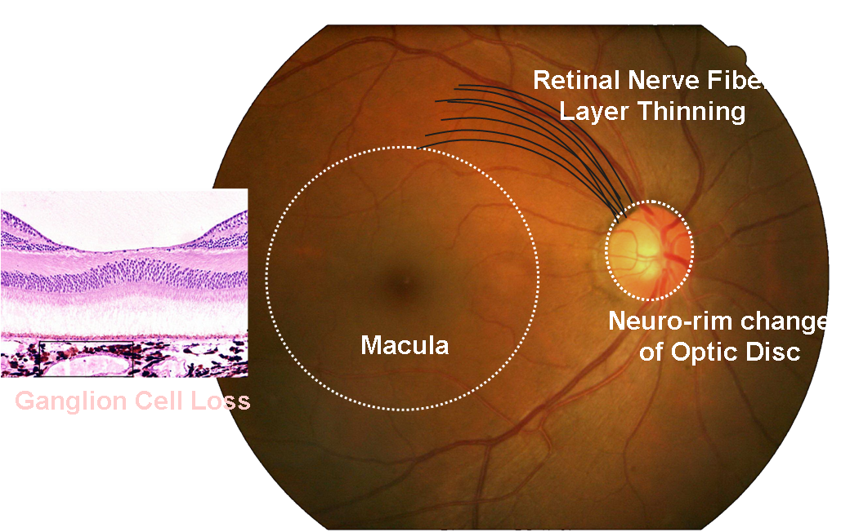
Areas of Glaucoma Damage
Notes:
Glaucoma damage areas including morphologic change of neuro-rim of optic disc, thinning of retinal nerve fiber layer and retinal ganglion cell aptosis in the macular area.

Slide 42
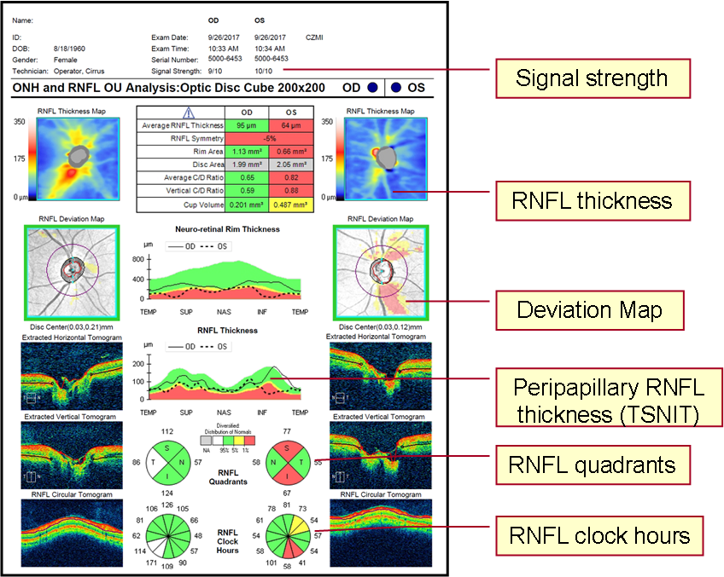
OCT Printout and Parameters of Optic Nerve
The quality of the scan image is important in peripapillary structure analysis using OCT.
Topographic map of retinal nerve fiber layer (RNFL) thickness
Map of RNFL deviation from normal values
RNFL TSINIT graph of measurements in the area analysed
Mean RNFL thickness in each quadrant
Mean RNFL thickness in each clock hours
Notes:
Glaucoma damage areas including morphologic change of neuro-rim of optic disc, thinning of retinal nerve fiber layer and retinal ganglion cell aptosis in the macular area.

Slide 43
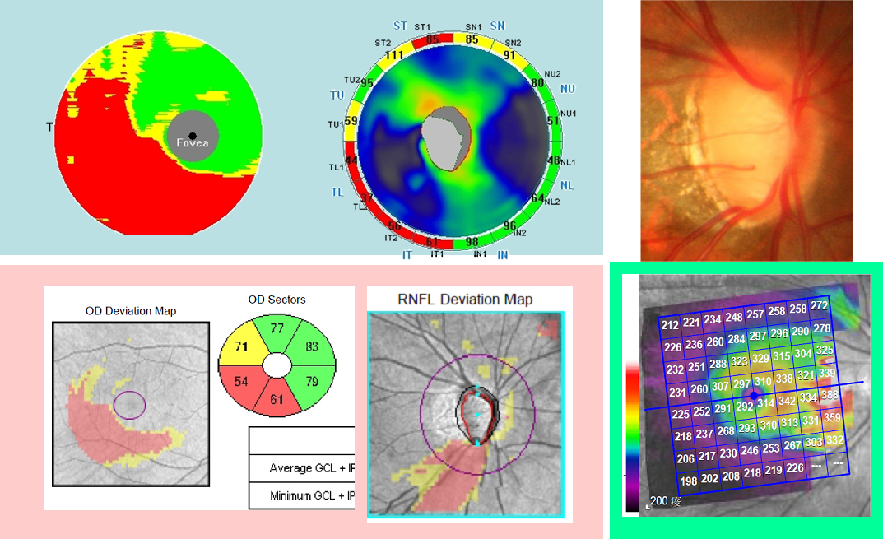
SD-OCT Macular Analysis
OCT’s Ganglion Cell Analysis
Notes:
Glaucoma damage areas including morphologic change of neuro-rim of optic disc, thinning of retinal nerve fiber layer and retinal ganglion cell aptosis in the macular area.

Slide 44
SD-OCT Macular Analysis
A combined structure and function data contribute to a better understanding of these relationship and may help in the future to improve glaucoma diagnosis.
Notes:
Using a combination of structural and functional analyses enhances physicians’ ability to detect glaucoma and its progression.

Slide 45
OCT in Glaucoma Management
The diagnosis of glaucoma and detection of glaucoma progression are based on structural and functional changes that occur in a characteristic pattern.
Evaluation of glaucomatous structural changes:
More objective
Quantifiable and reproducible measurements
For the diagnosis of early glaucoma, both macular and optic disc scans should be used.
Understanding the limitations of imaging technologies coupled with evaluation of serial OCT analyses and structure–function correlation is important to avoid missing real glaucoma requiring treatment.
Notes:
Once vision is lost from glaucoma, it can never be restored. Early detection of glaucoma, which is often asymptomatic until extremely advanced, is critical to prevent disease progression and permanent blindness. This requires a full eye examination.
The key points listed in this slide emphasise the importance of both history taking and examination in diagnosing glaucoma. The information obtained from tonometry, optic nerve evaluation and visual field testing must be considered together with the patient’s clinical profile in order to diagnose glaucoma and to evaluate the patient’s future risk. As structural damage generally precedes functional loss, examination of the optic nerve head and retinal nerve fibre layer may be the most critical component of glaucoma assessment.

Slide 46
Thank you!

